Slide 1
Device Teardown & eMMC Chip-off

Slide 2
Why to Teardown Device & Chip-off eMMC
Data is stored in internal storage within an Echo Show Device.
The internal storage is a non-volatile storage.
The chip responsible for storage is known as eMMC (embedded MultiMedia Card).
The eMMC is located on the motherboard/logic board of the device.
External access to the eMMC is not possible through conventional means.
Rooting the device via debugging mode, a typical method for external access, has been disabled in Echo Show Device (2nd Gen.) and newer models.
The only available method is a destructive chip-off approach to remove the eMMC.

Slide 3
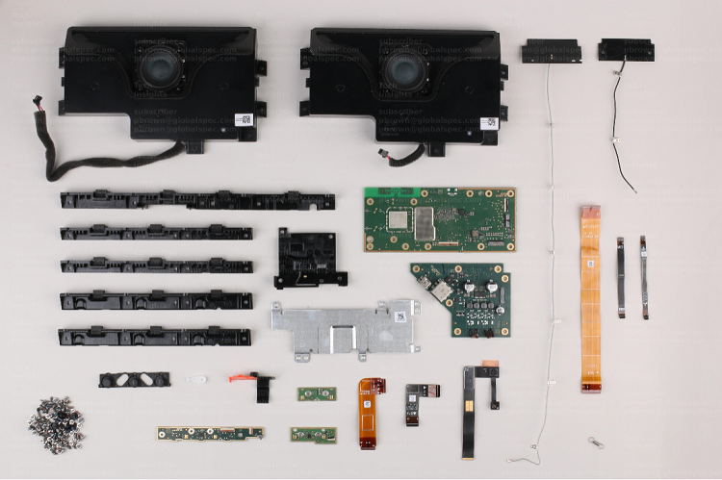
Device Teardown
Image Source: TechInsights Teardown: Amazon Echo Show 15 | Electronics360 (globalspec.com)

Slide 4
Teardown Summary
Remove back cover
Five T6 screws
Two adhesive tapes & connections
Separate speaker from screen
Six T5 screws
Five adhesive tapes & connections
One audio connection to the speaker (to be removed after separating the logic board from the screen
Separate logic board from screen
Nine T5 screws
Five adhesive tapes & connections

Slide 5
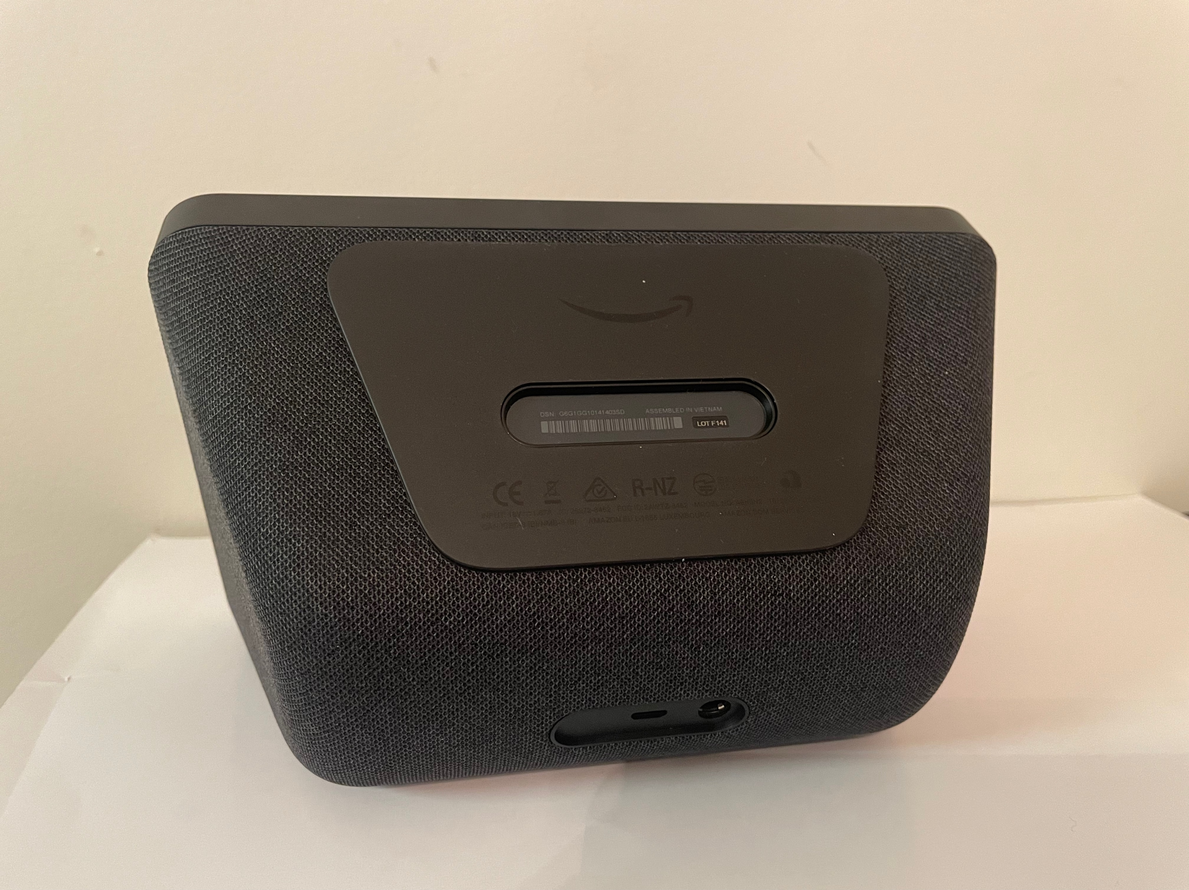
Remove the Bottom Plate

Slide 6
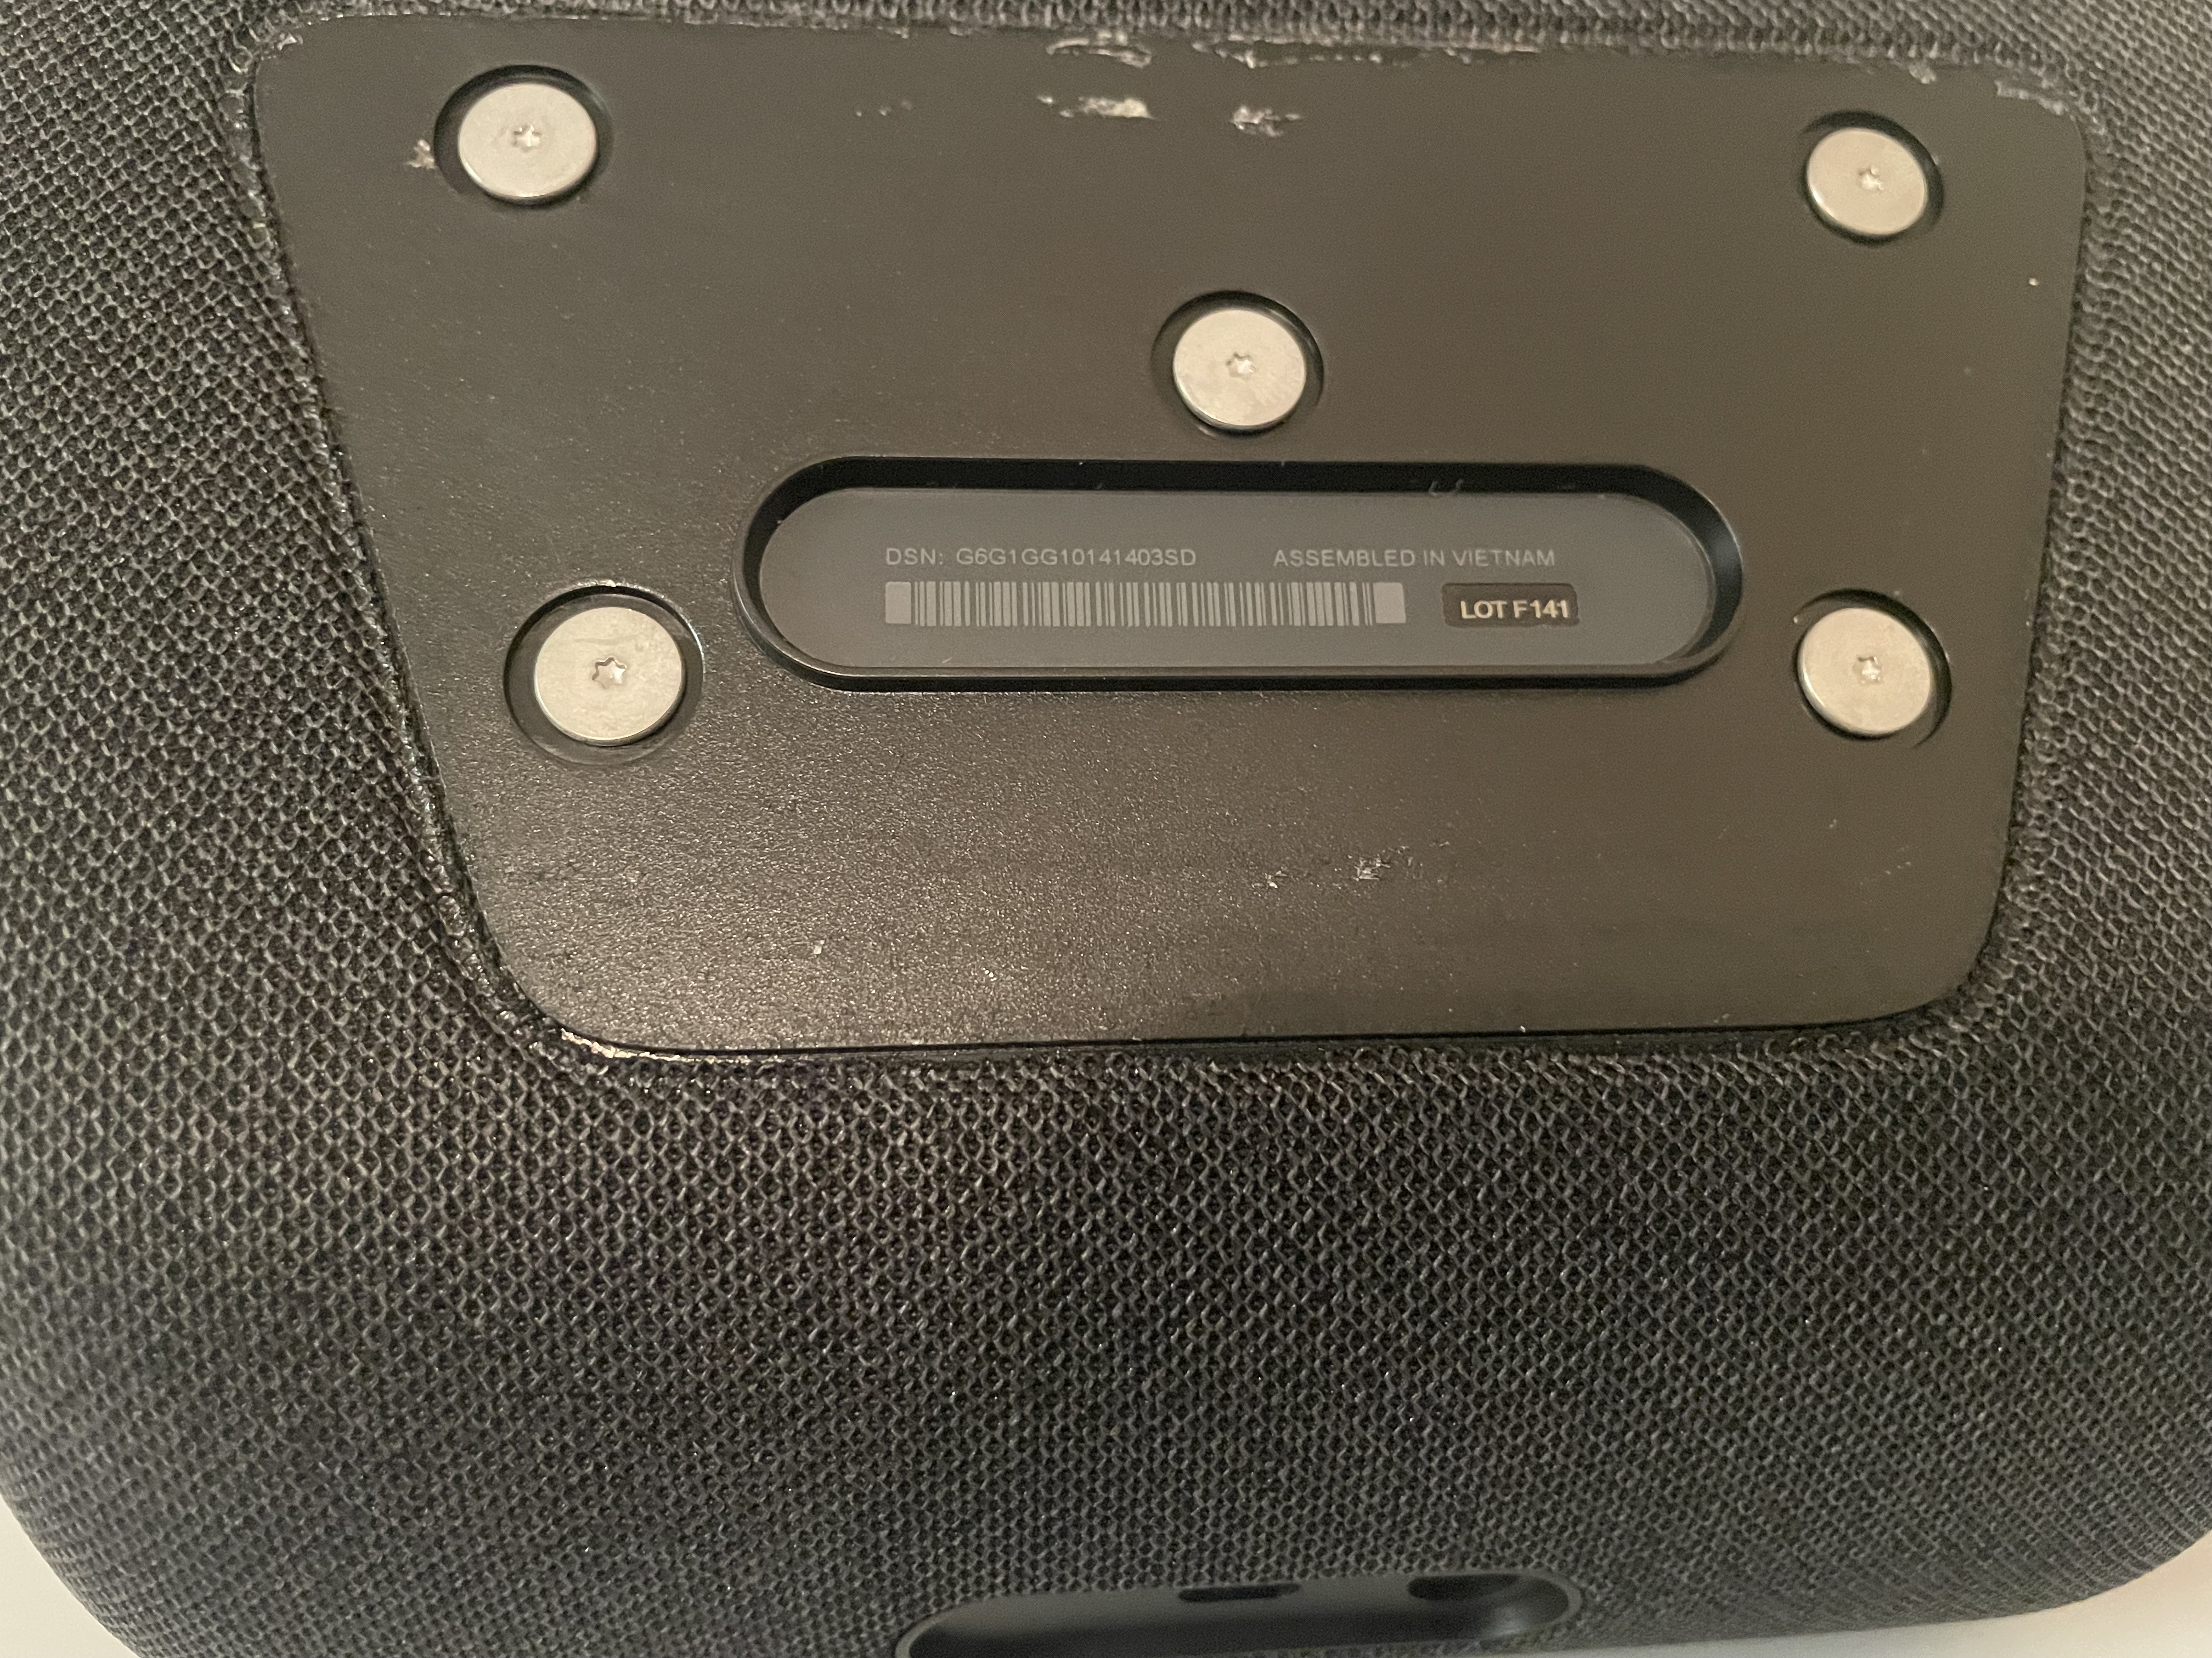
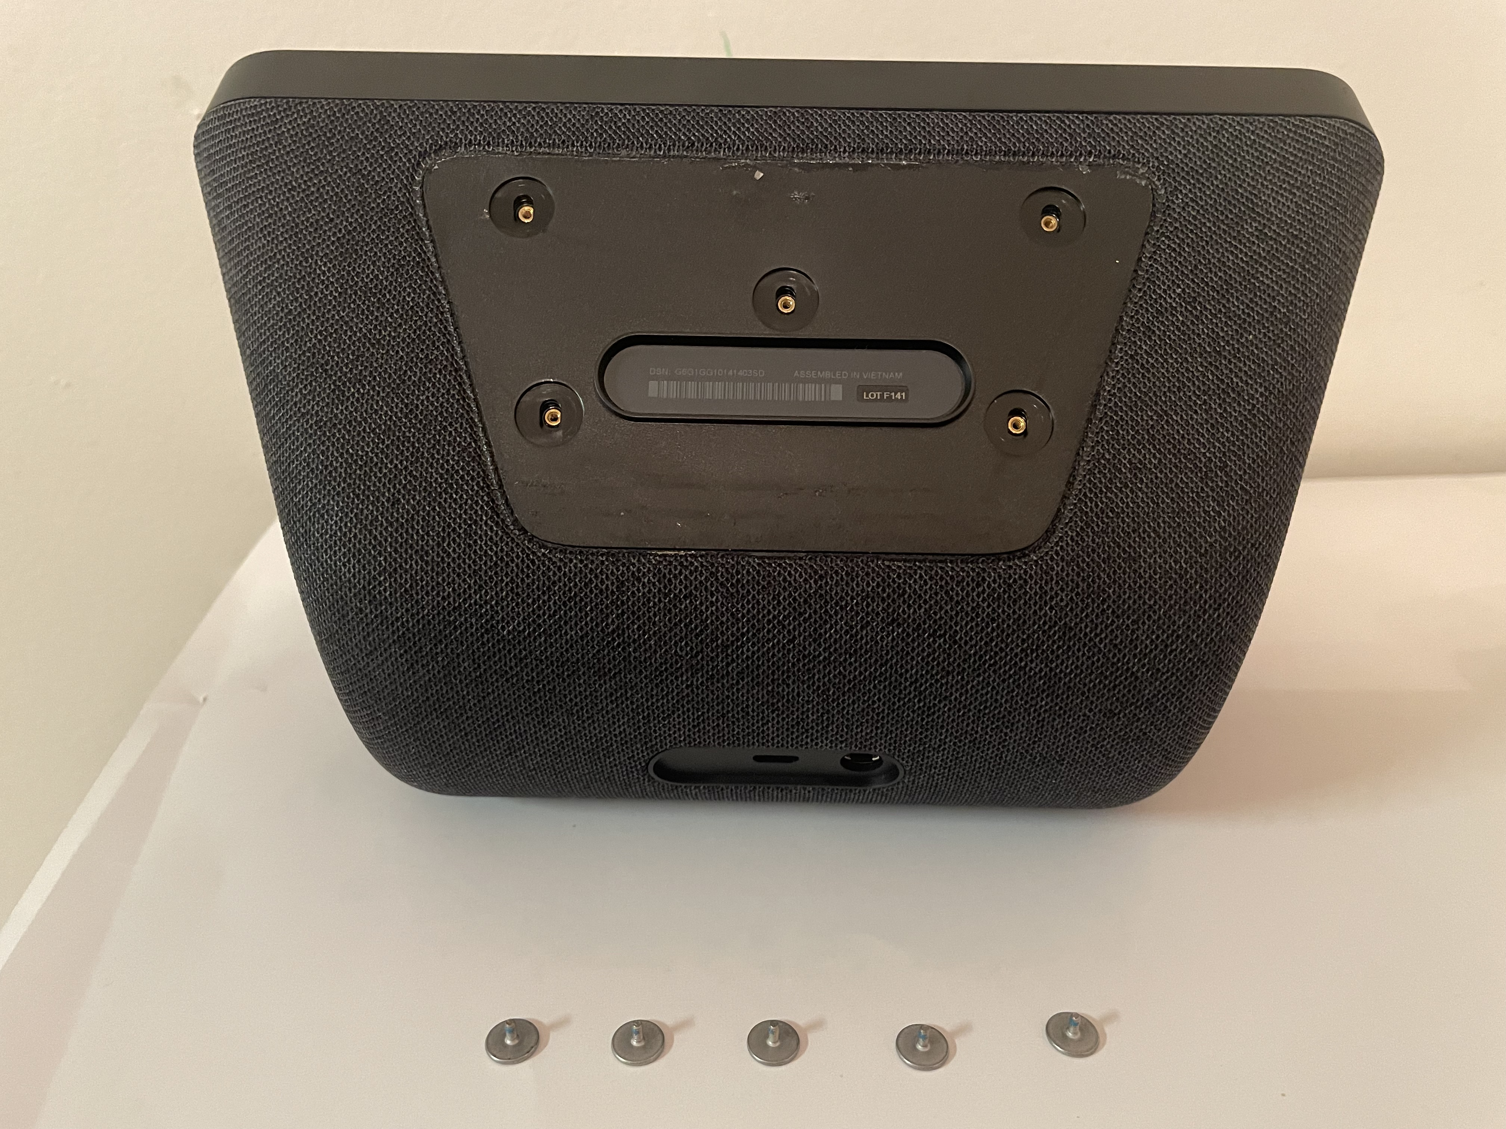
Remove the 5 T6 Screws from Bottom

Slide 7
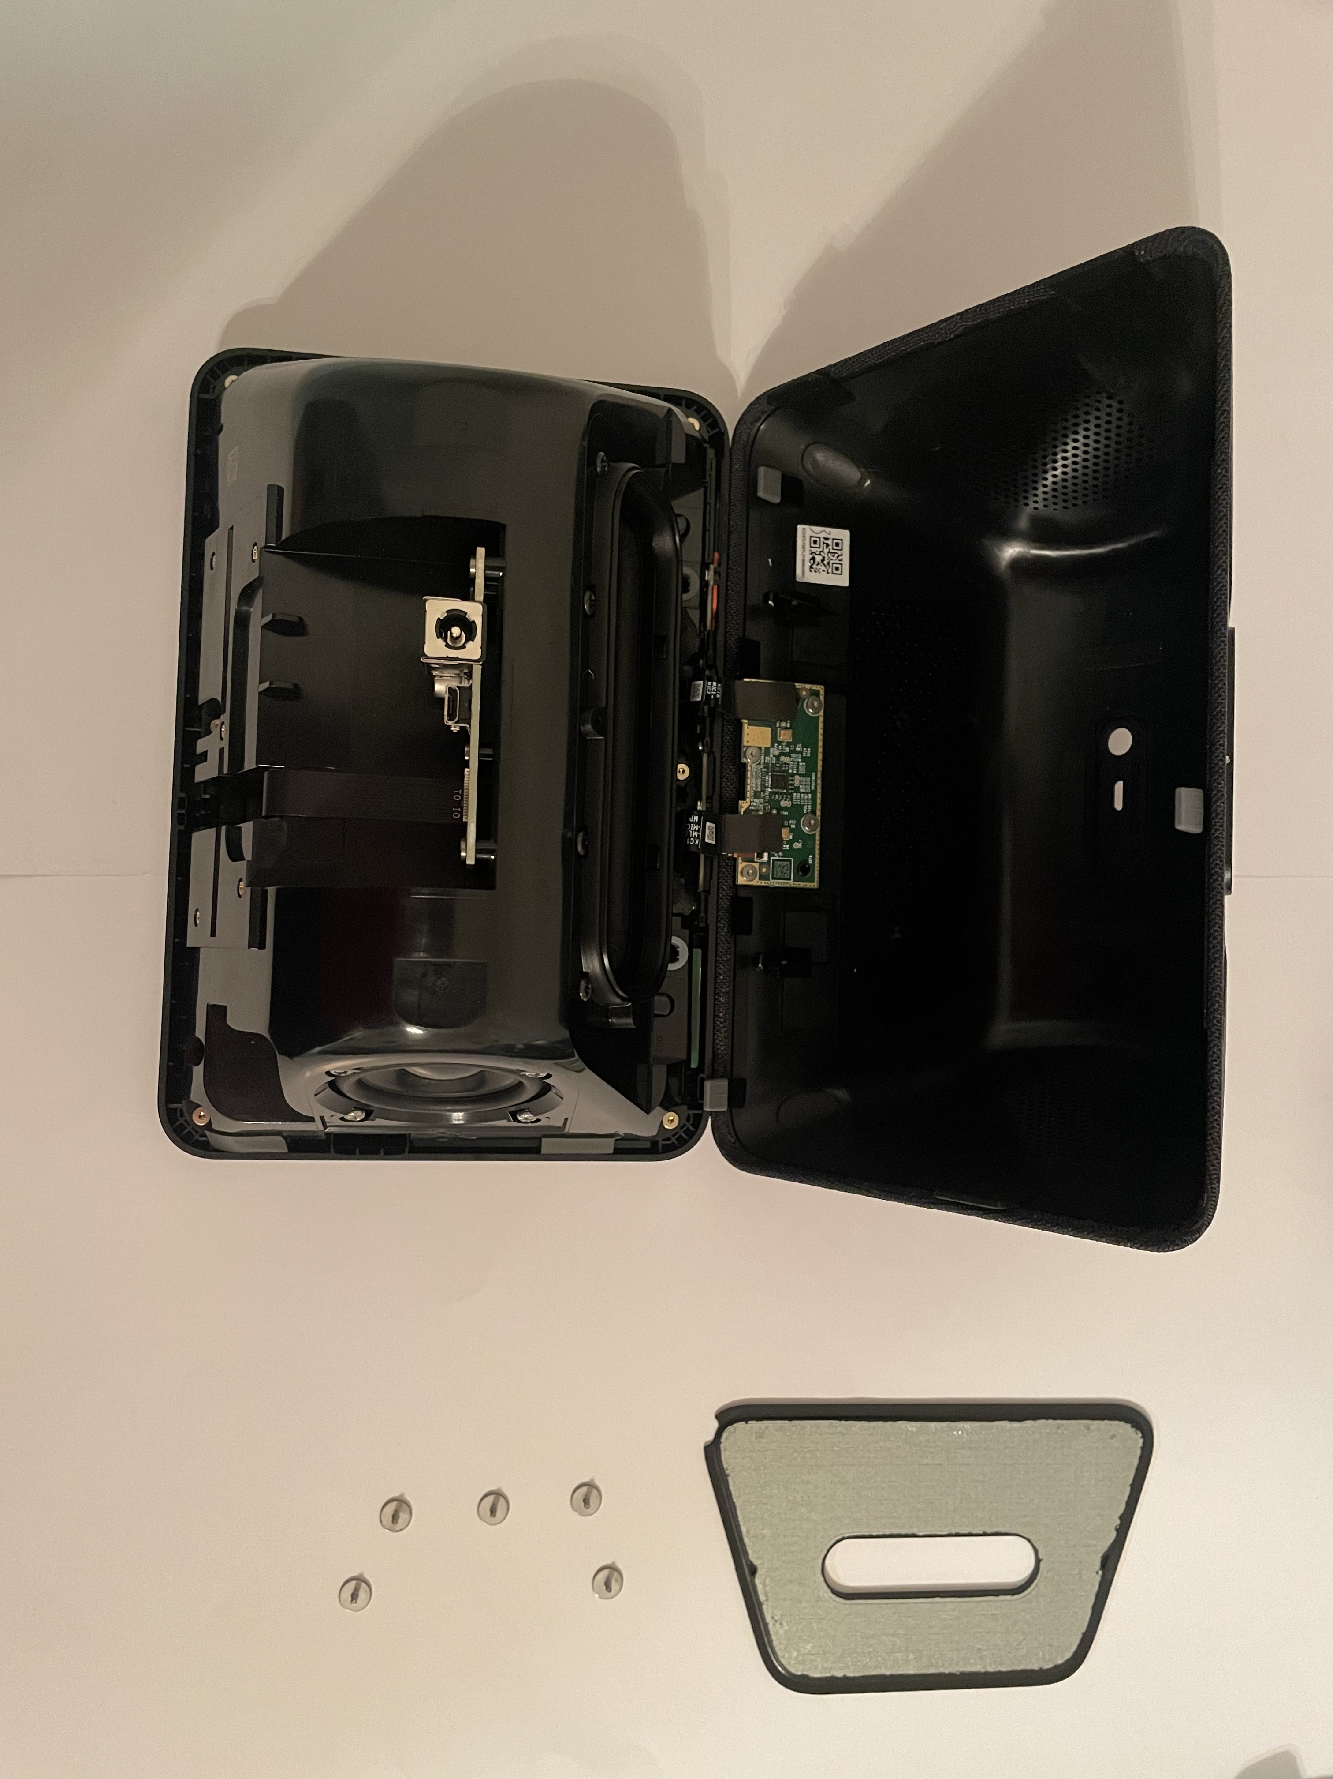
Open the Back Cover & Remove 2 Connections

Slide 8
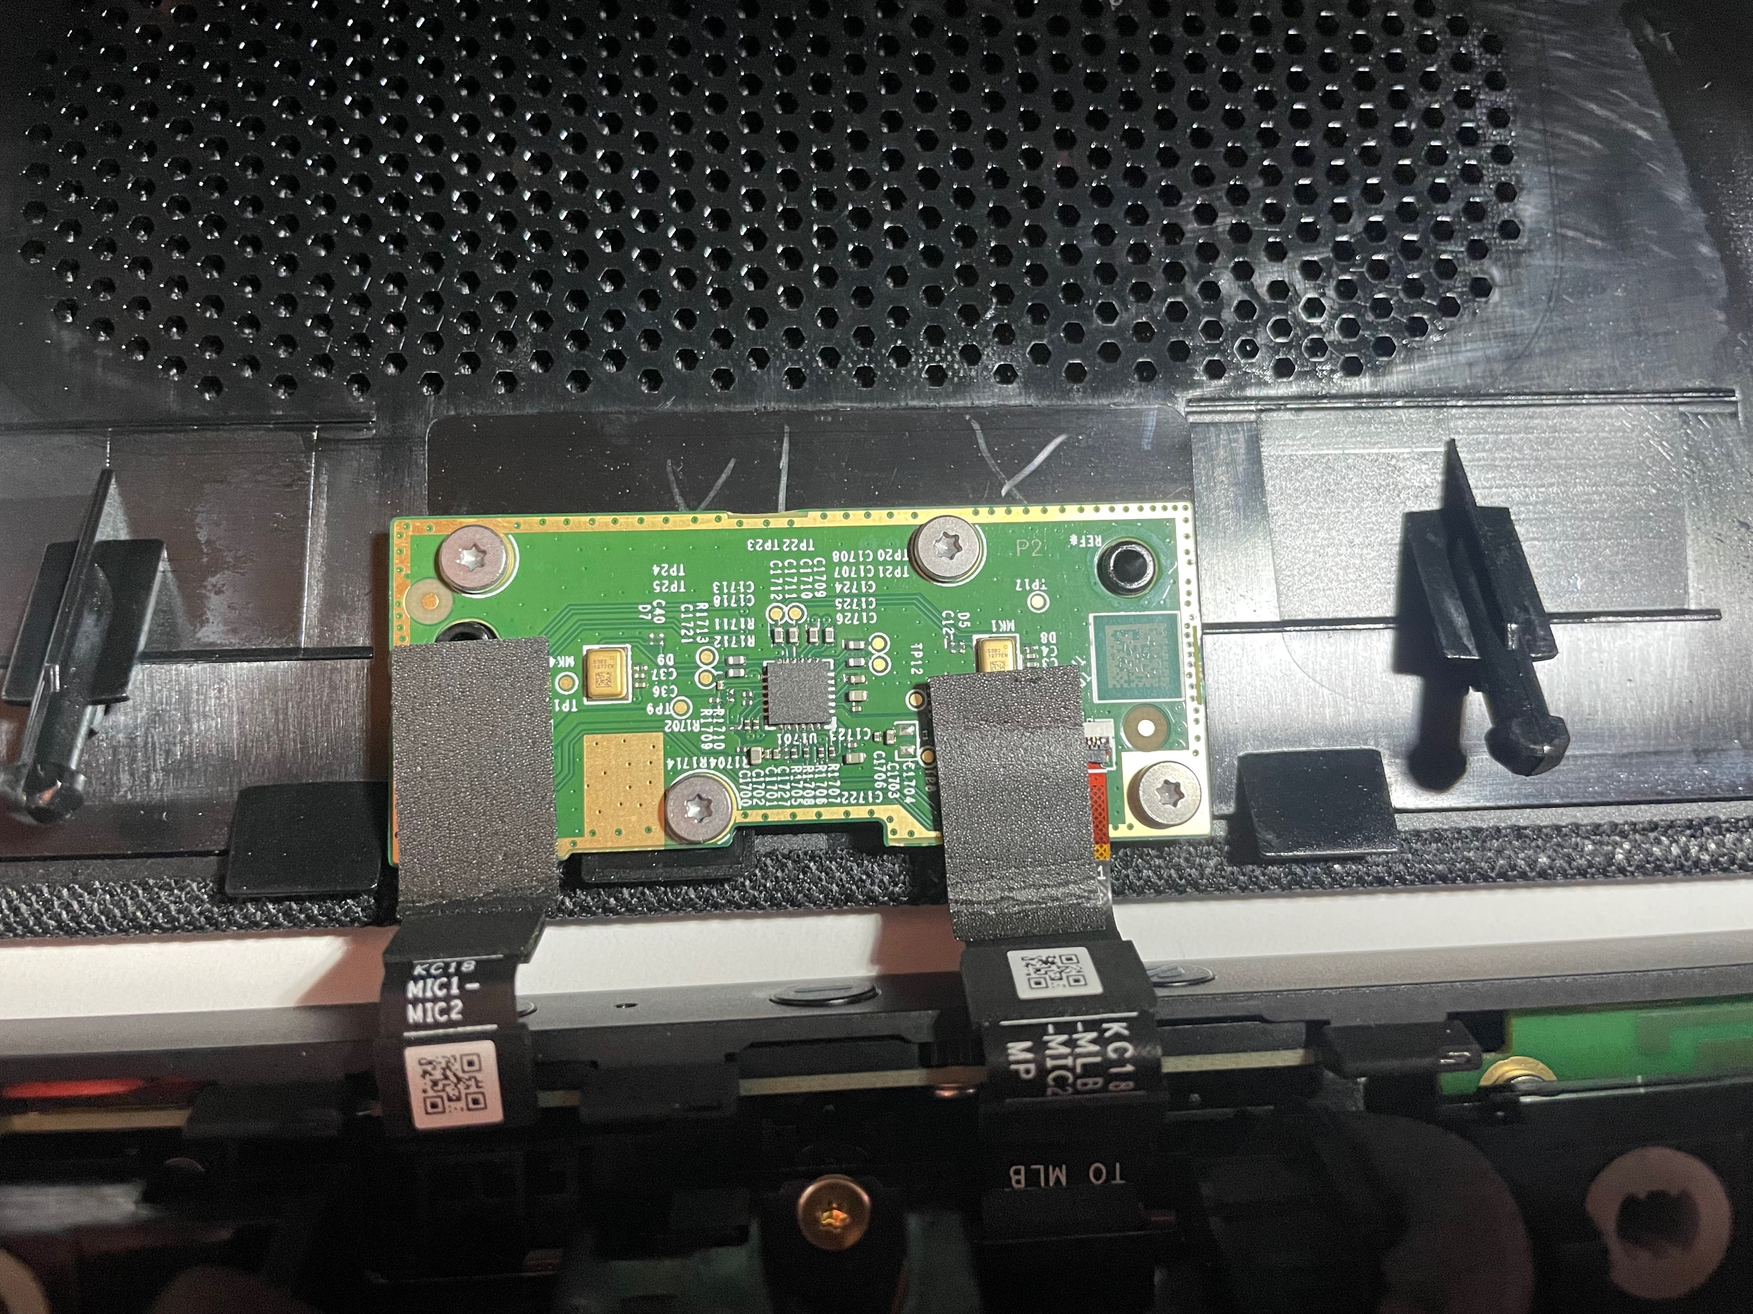
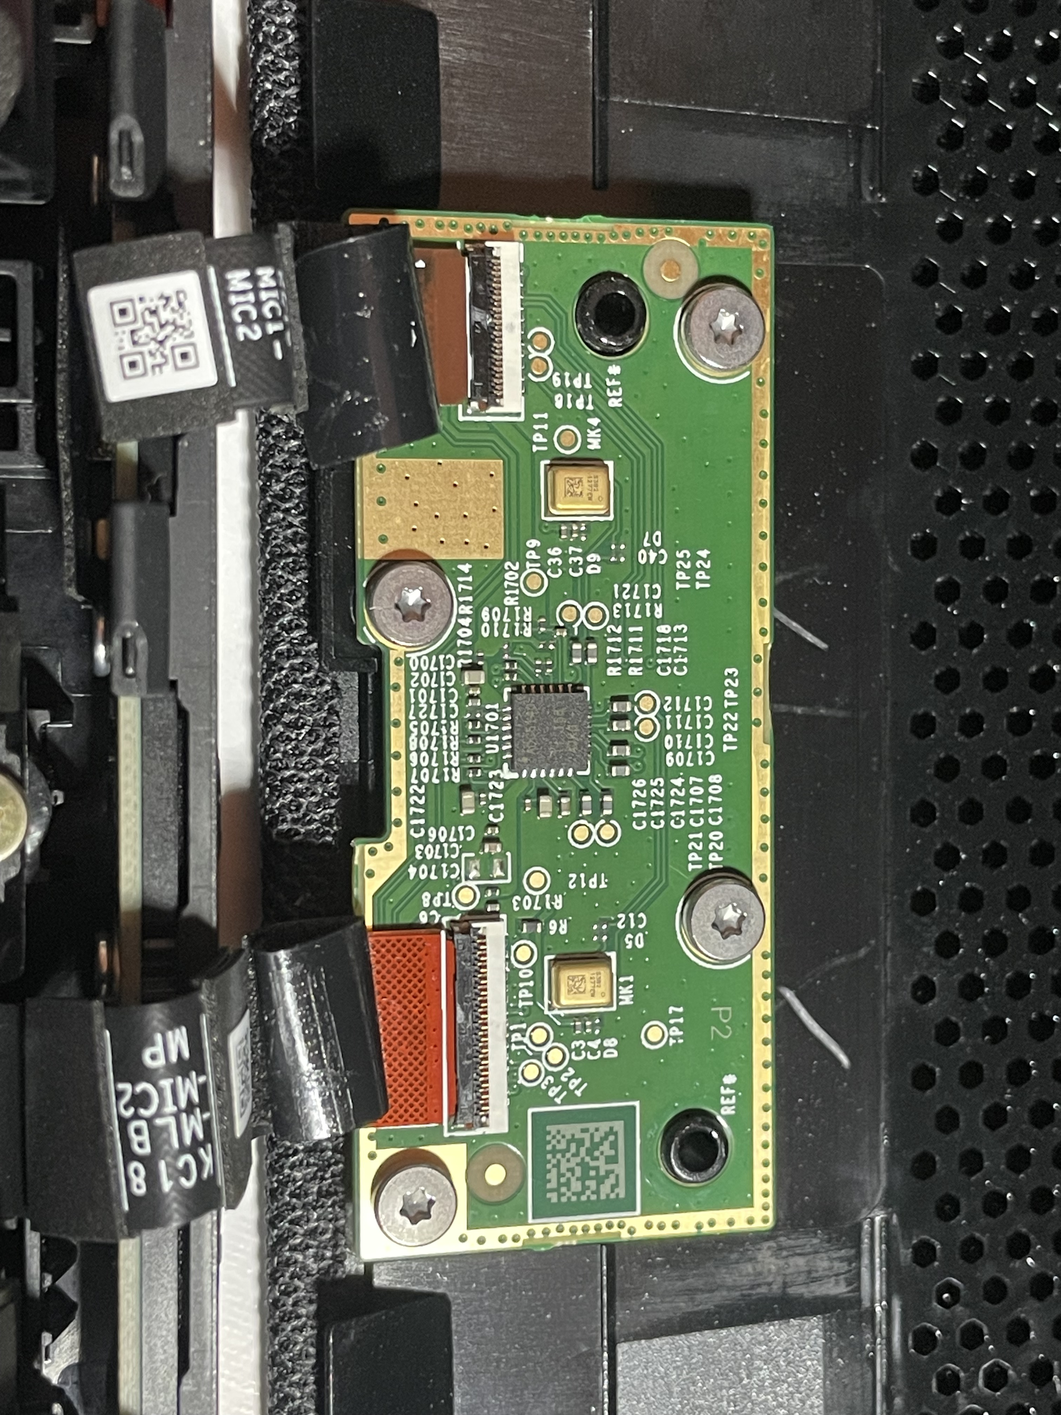
Remove the Adhesive Tape to Expose Contact

Slide 9
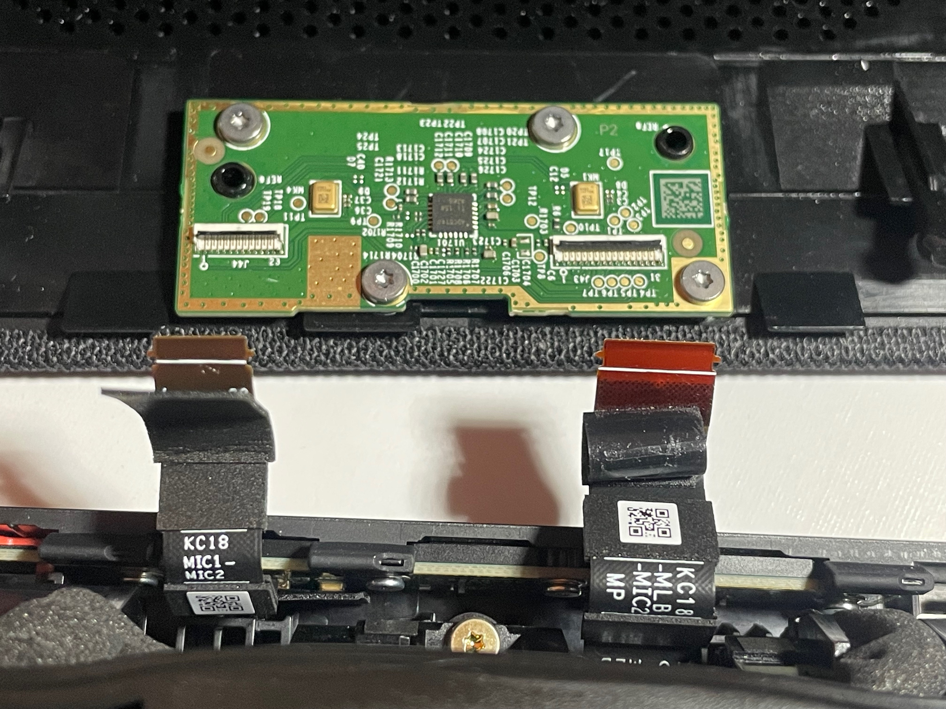
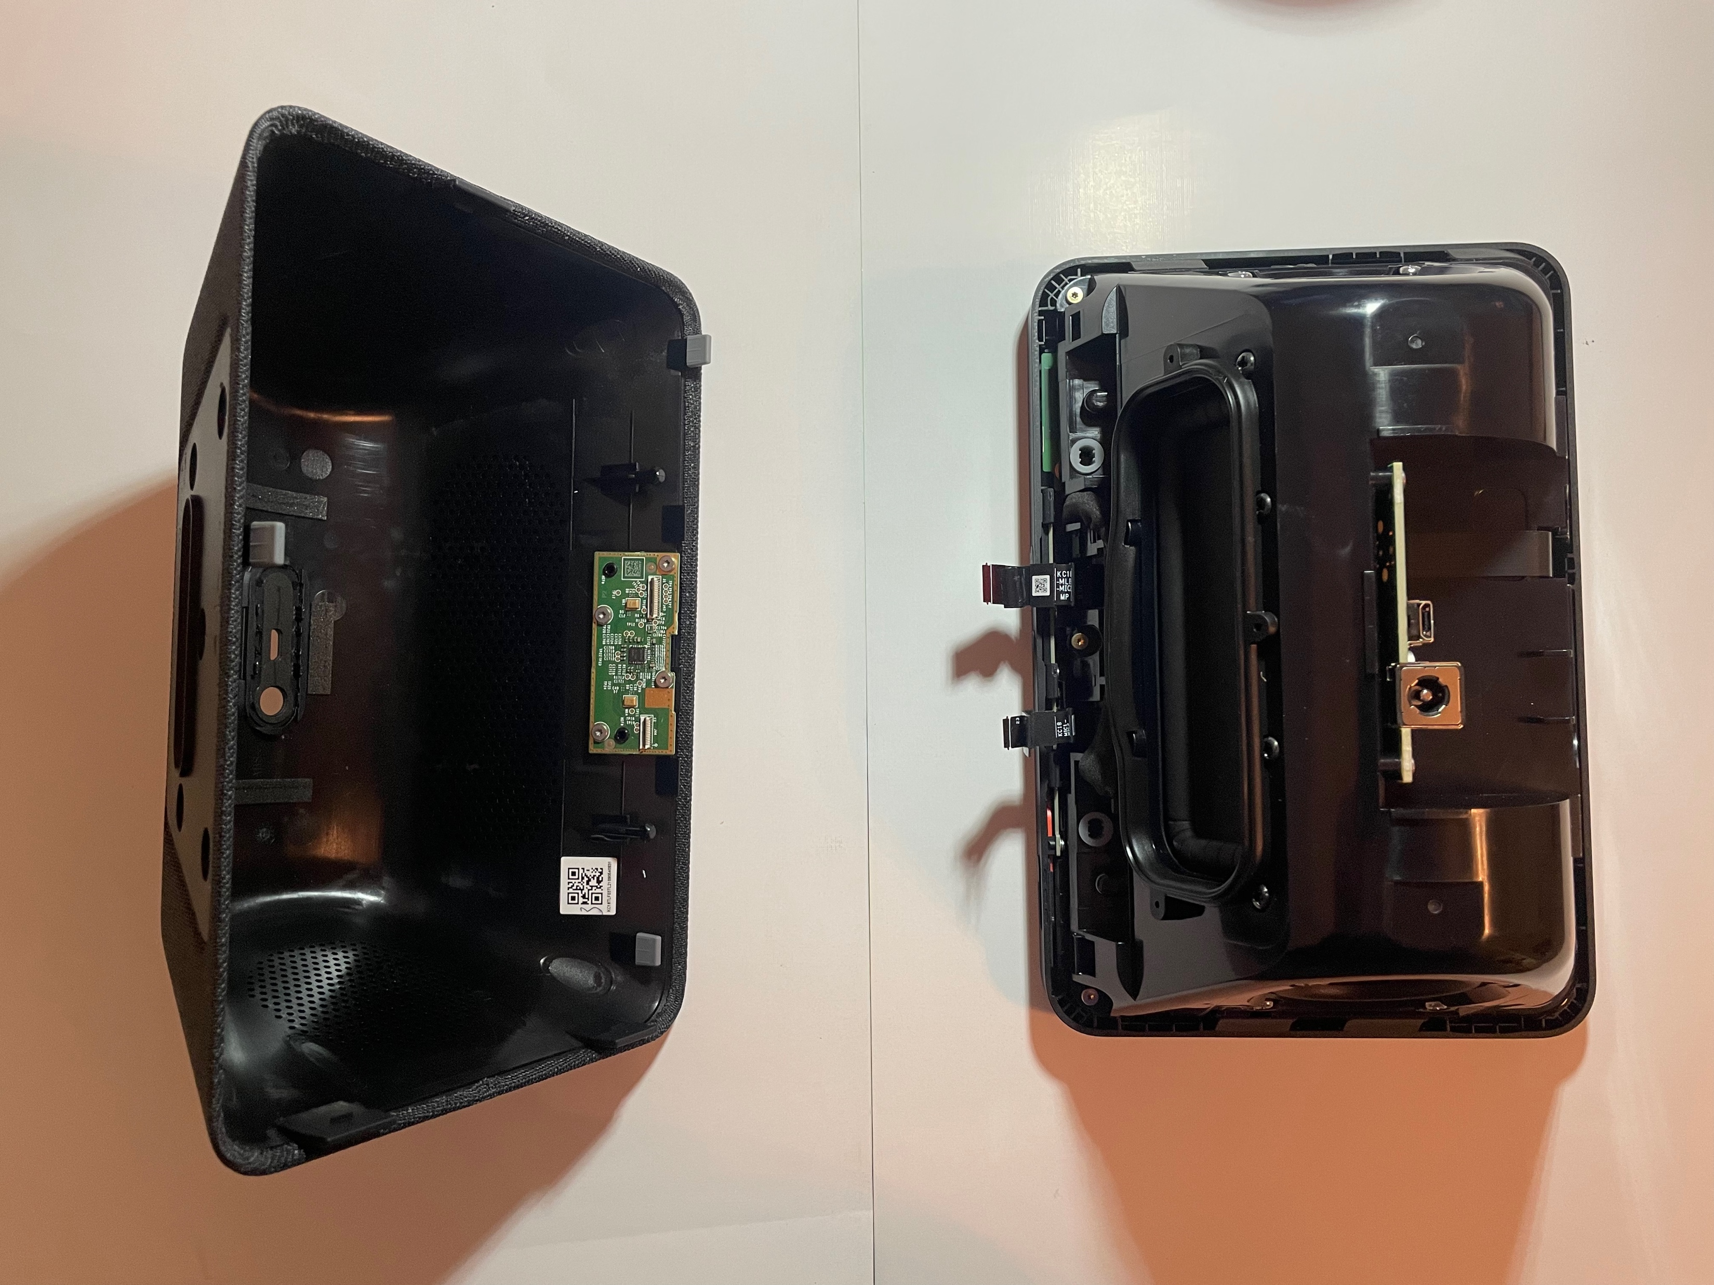
Remove the Connection to Separate Cover & Body

Slide 10
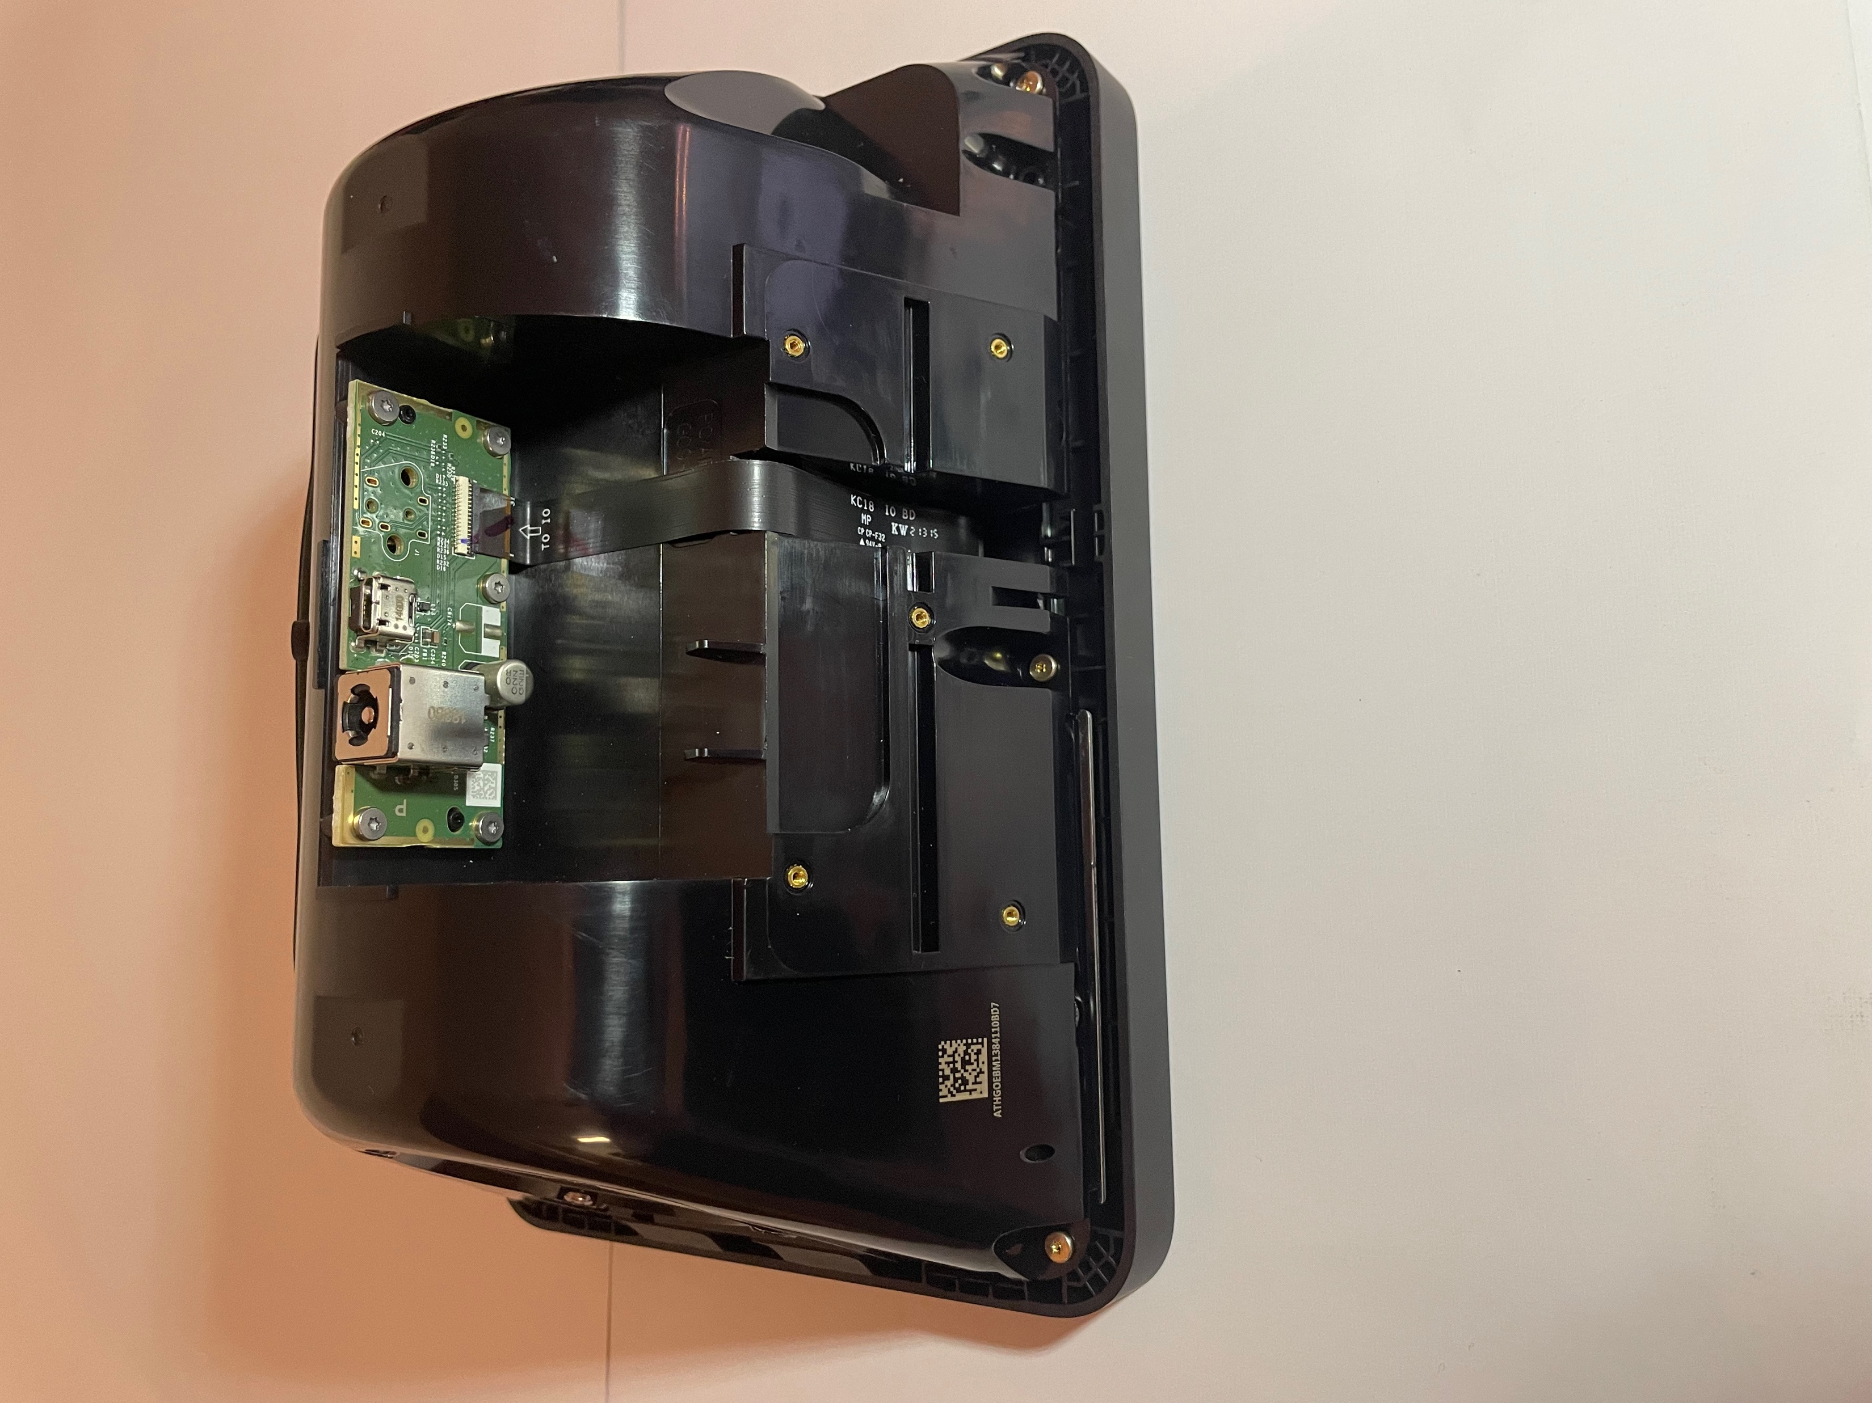
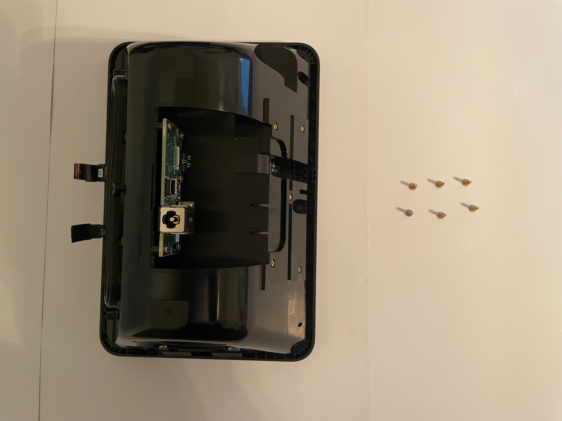
Remove Six ‘T5’ Screws to Separate Body from Screen

Slide 11
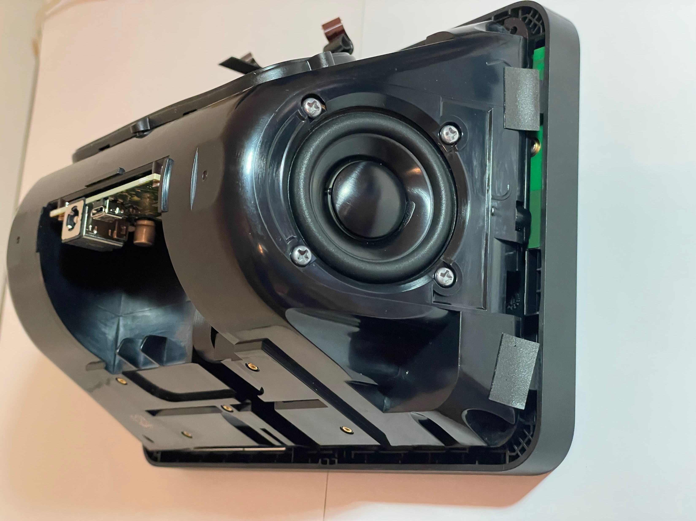
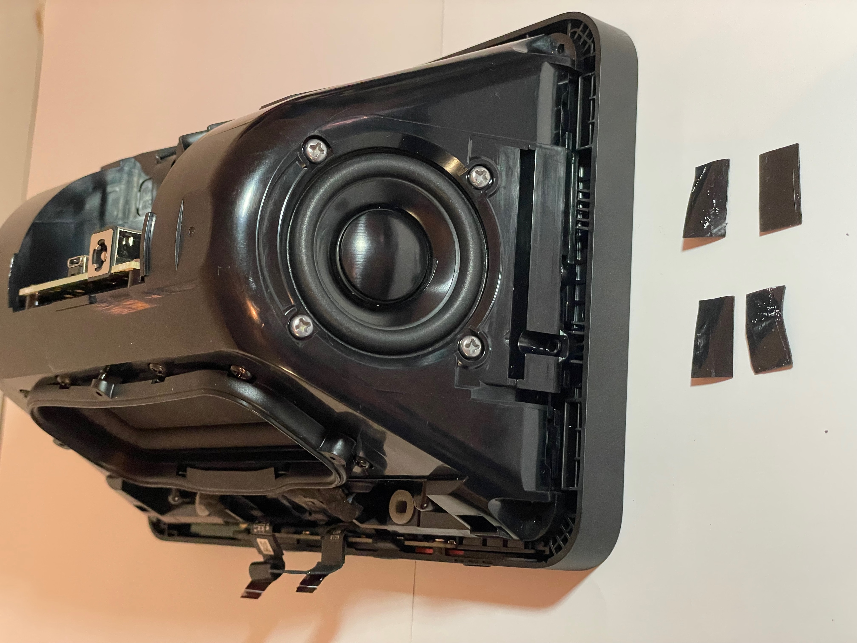
Remove the 4 Adhesive Tapes to Expose Contact

Slide 12
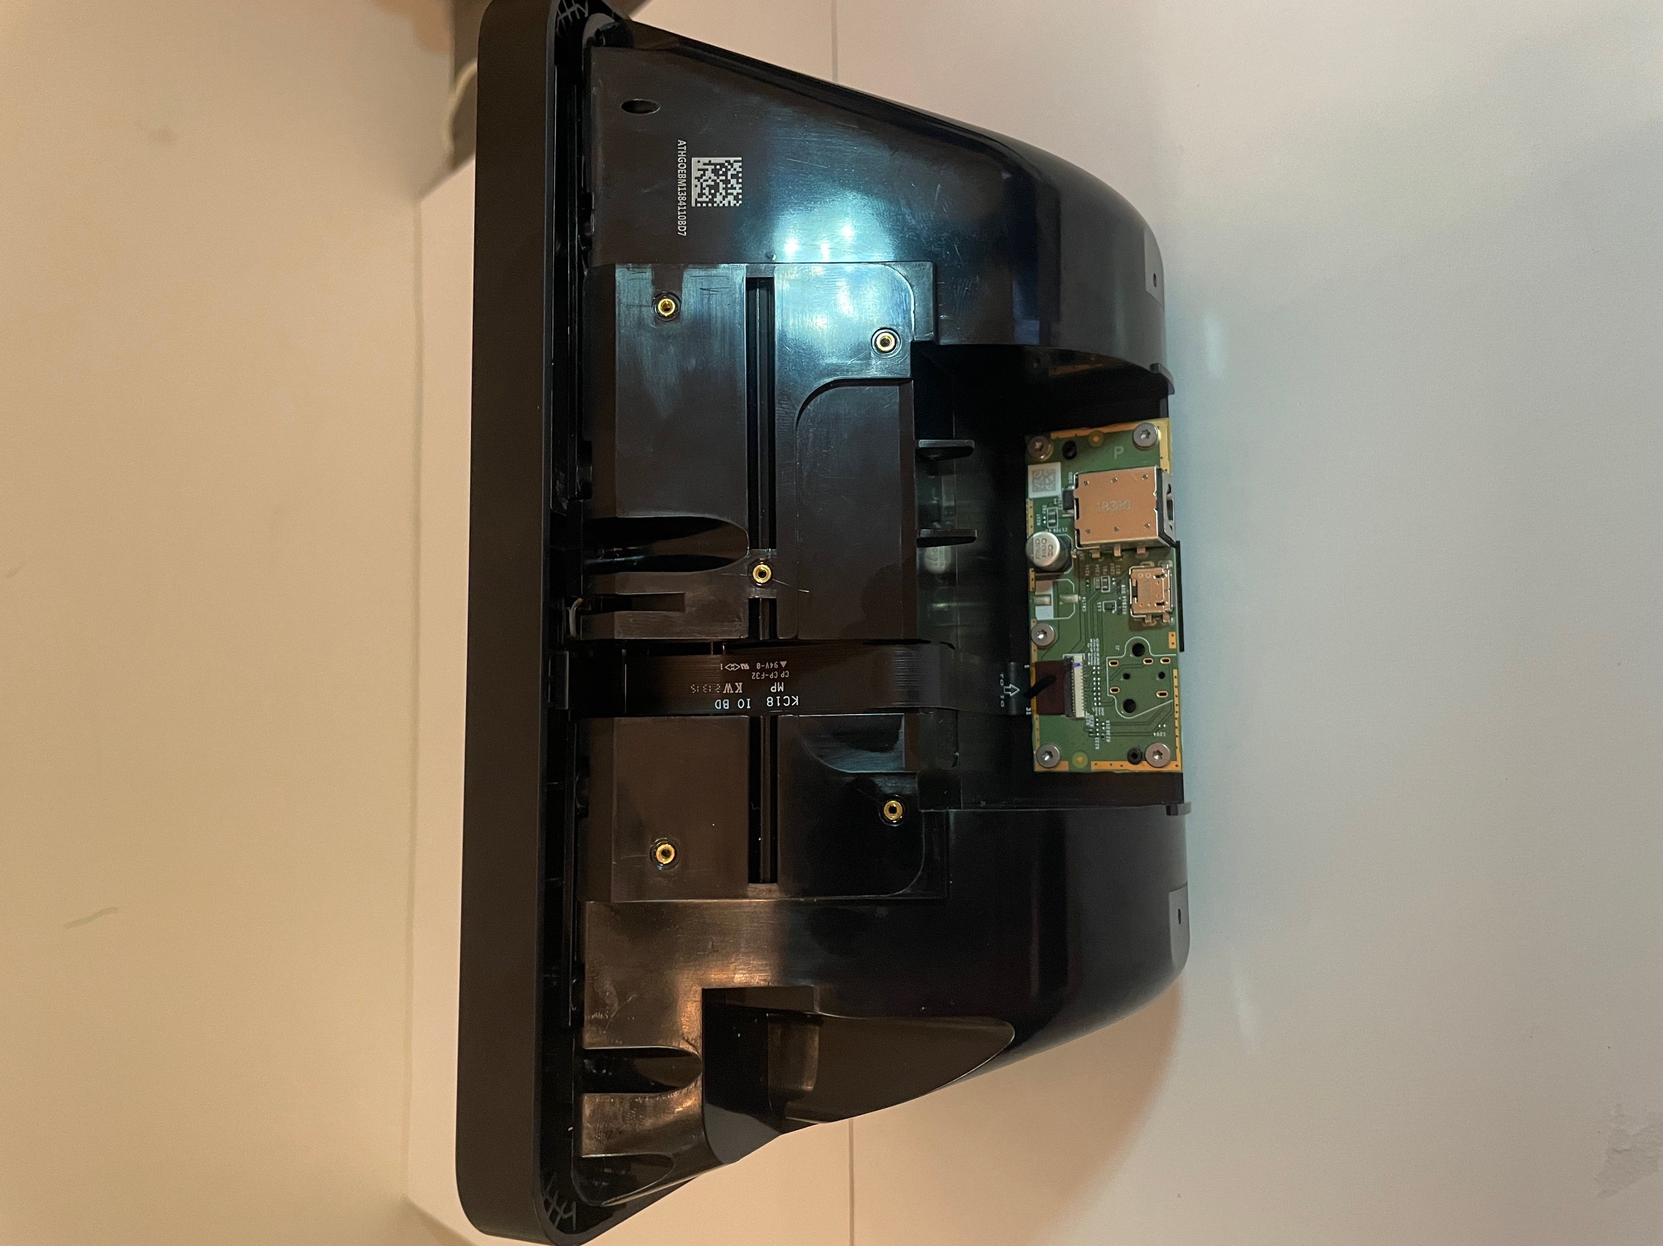
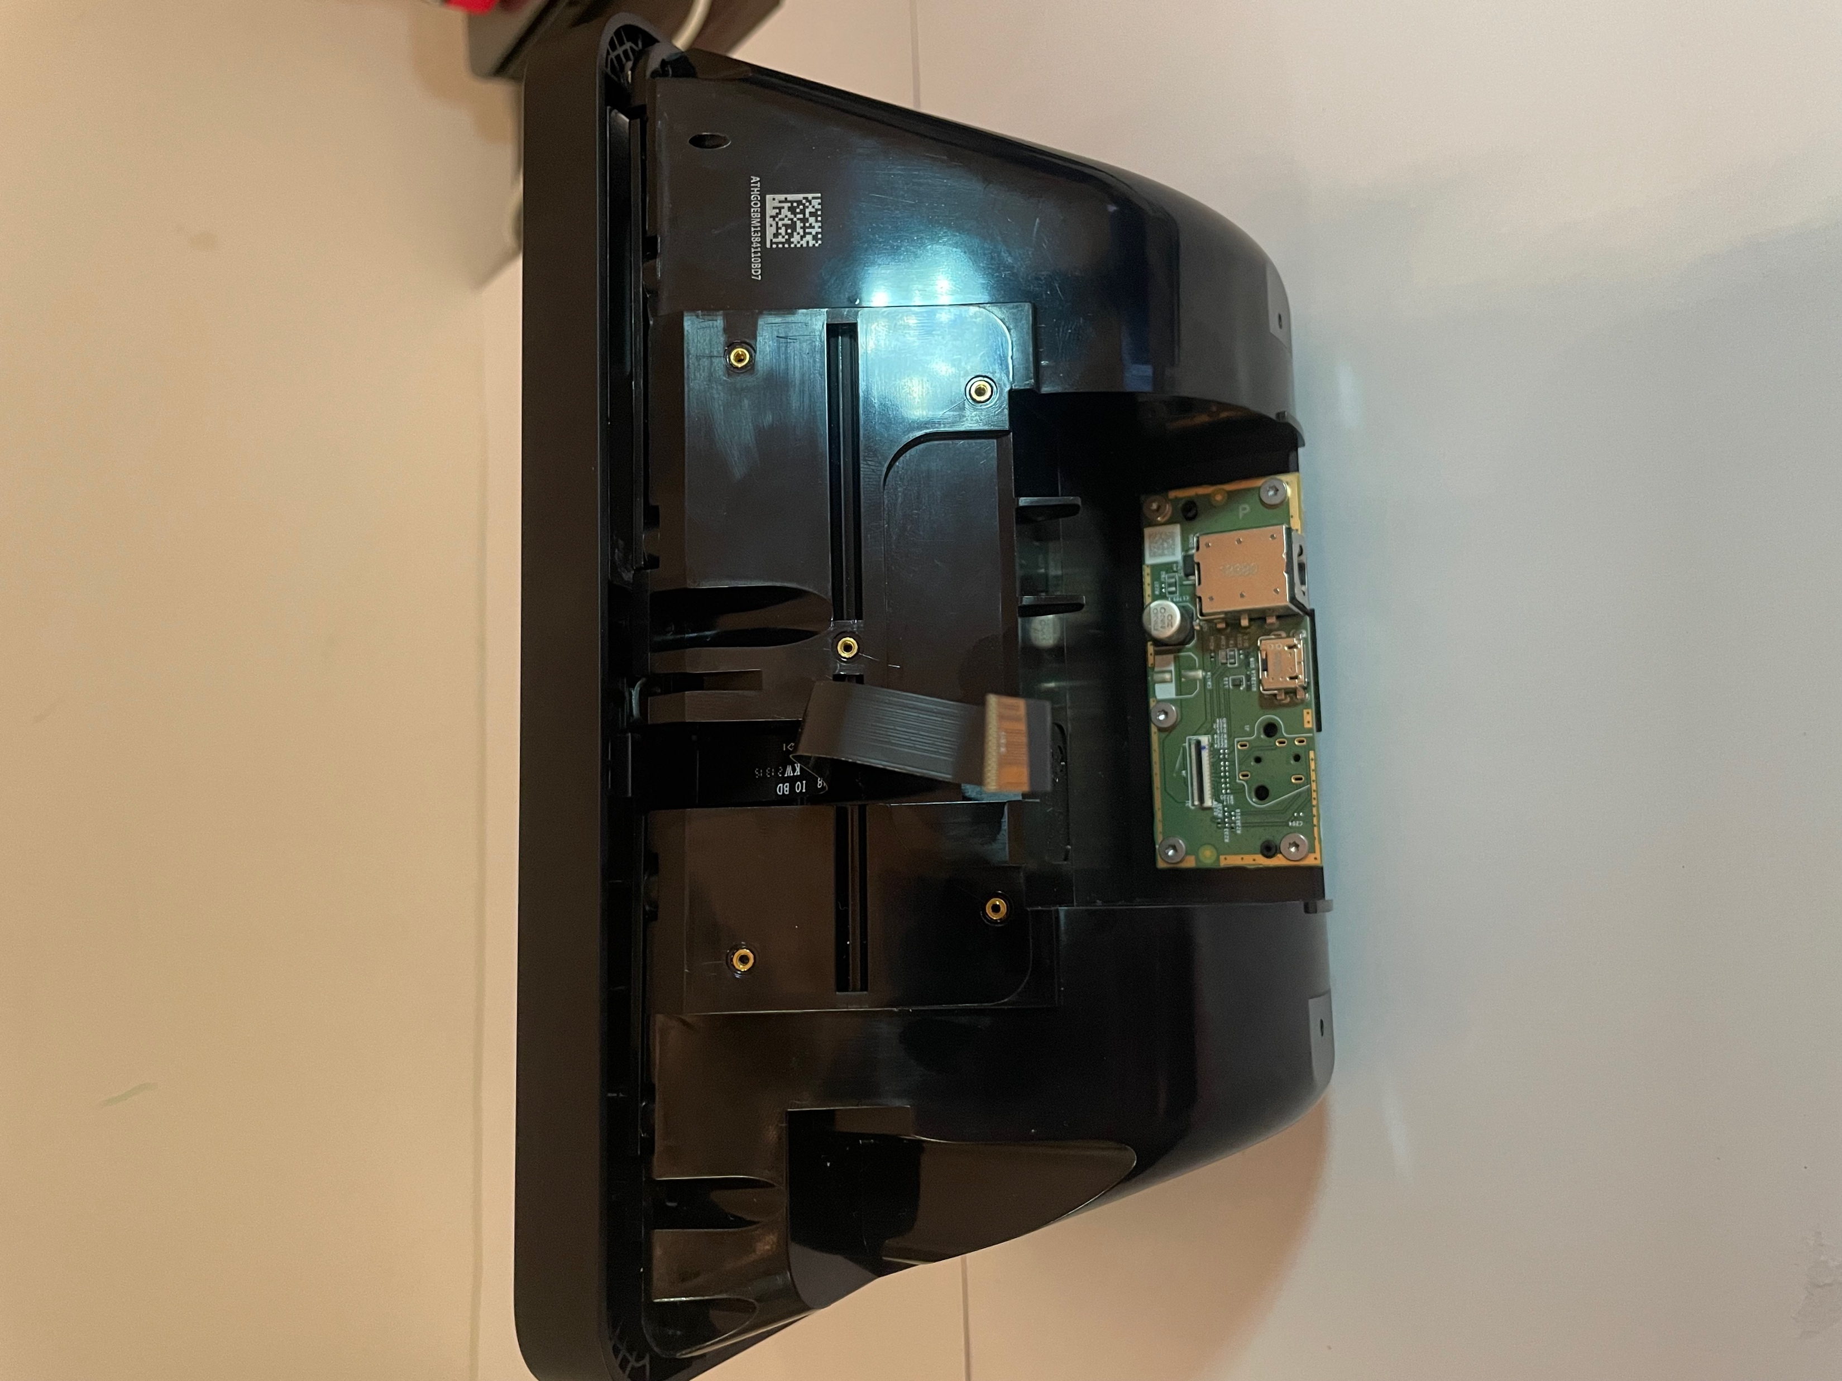
Remove the Connection

Slide 13
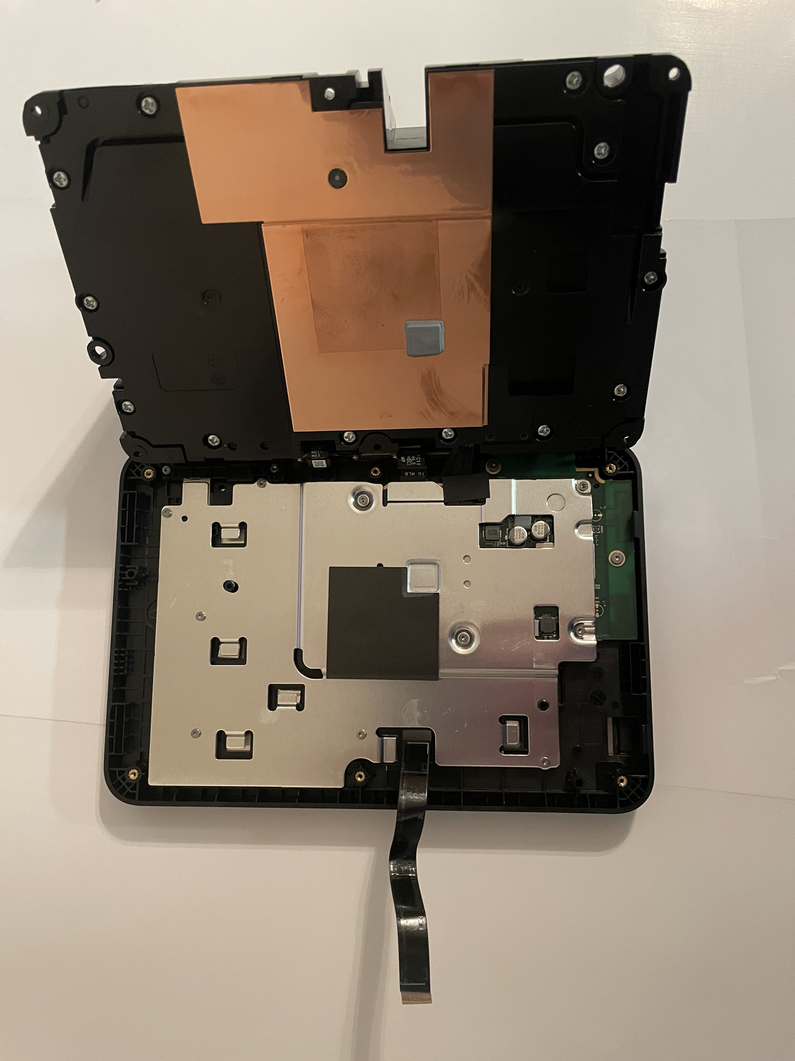
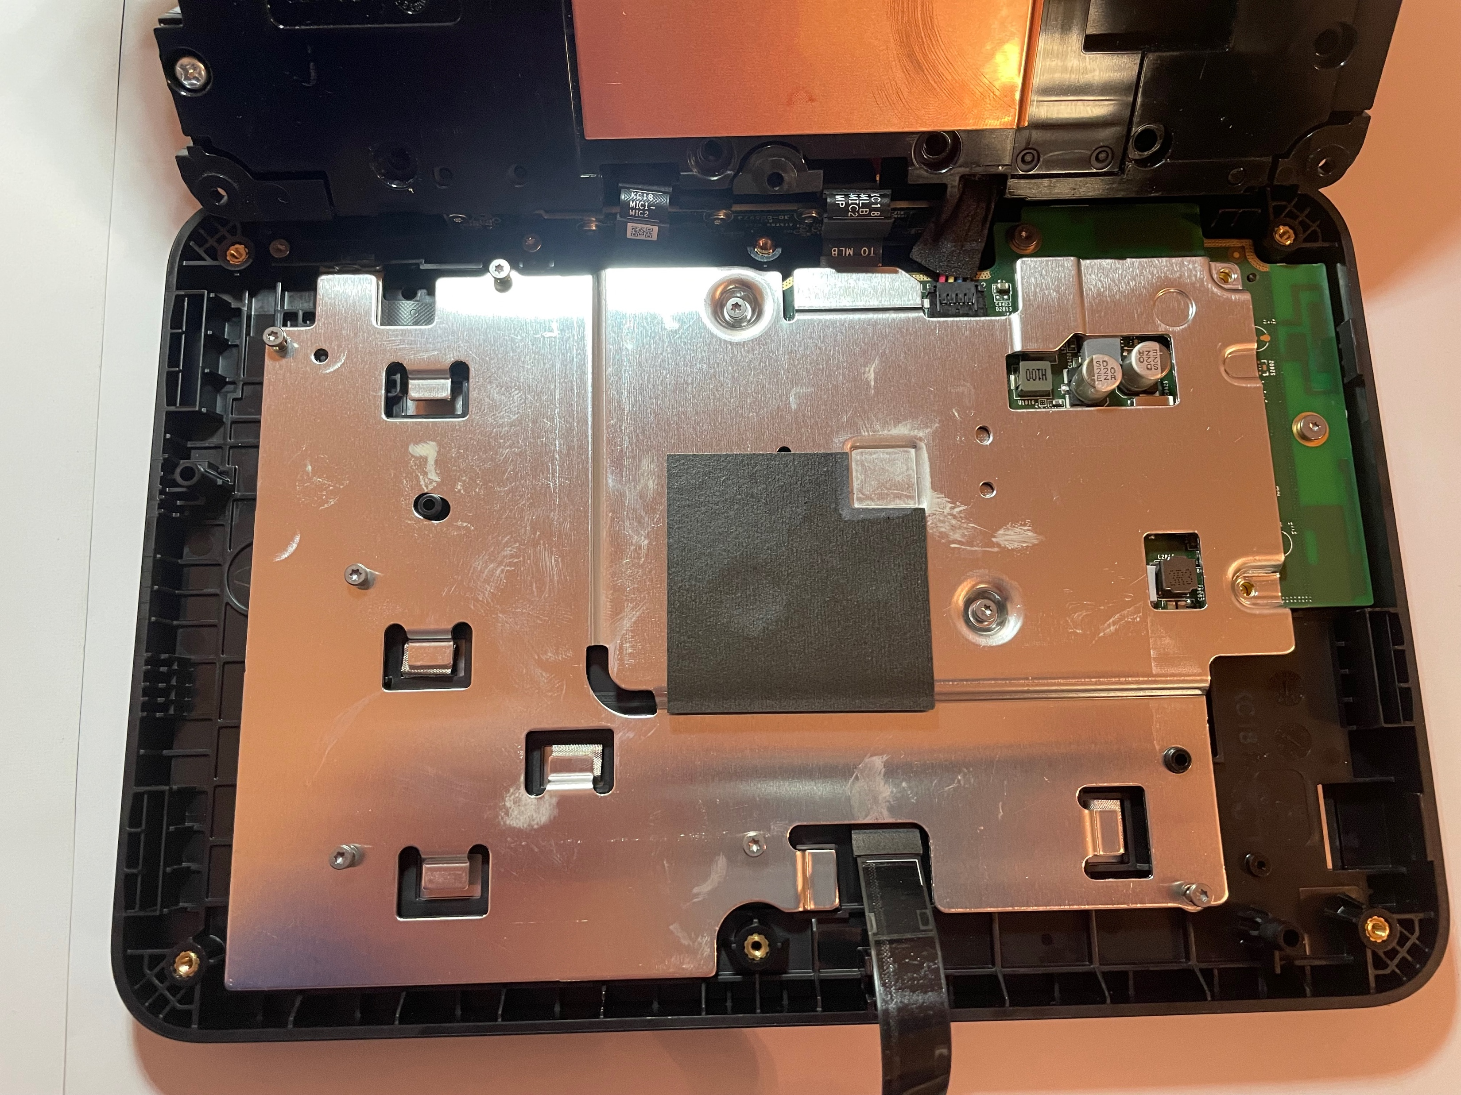
Remove T5 screws to Expose Logic Board

Slide 14
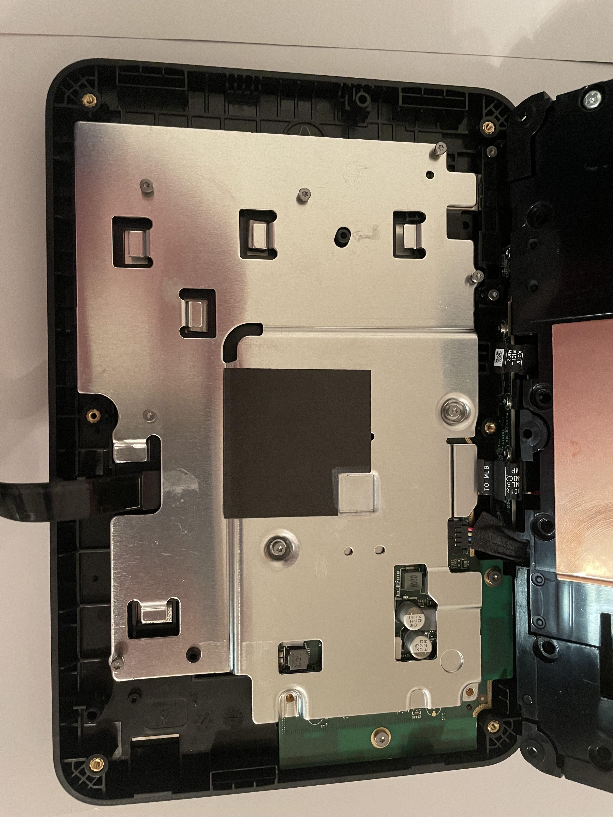
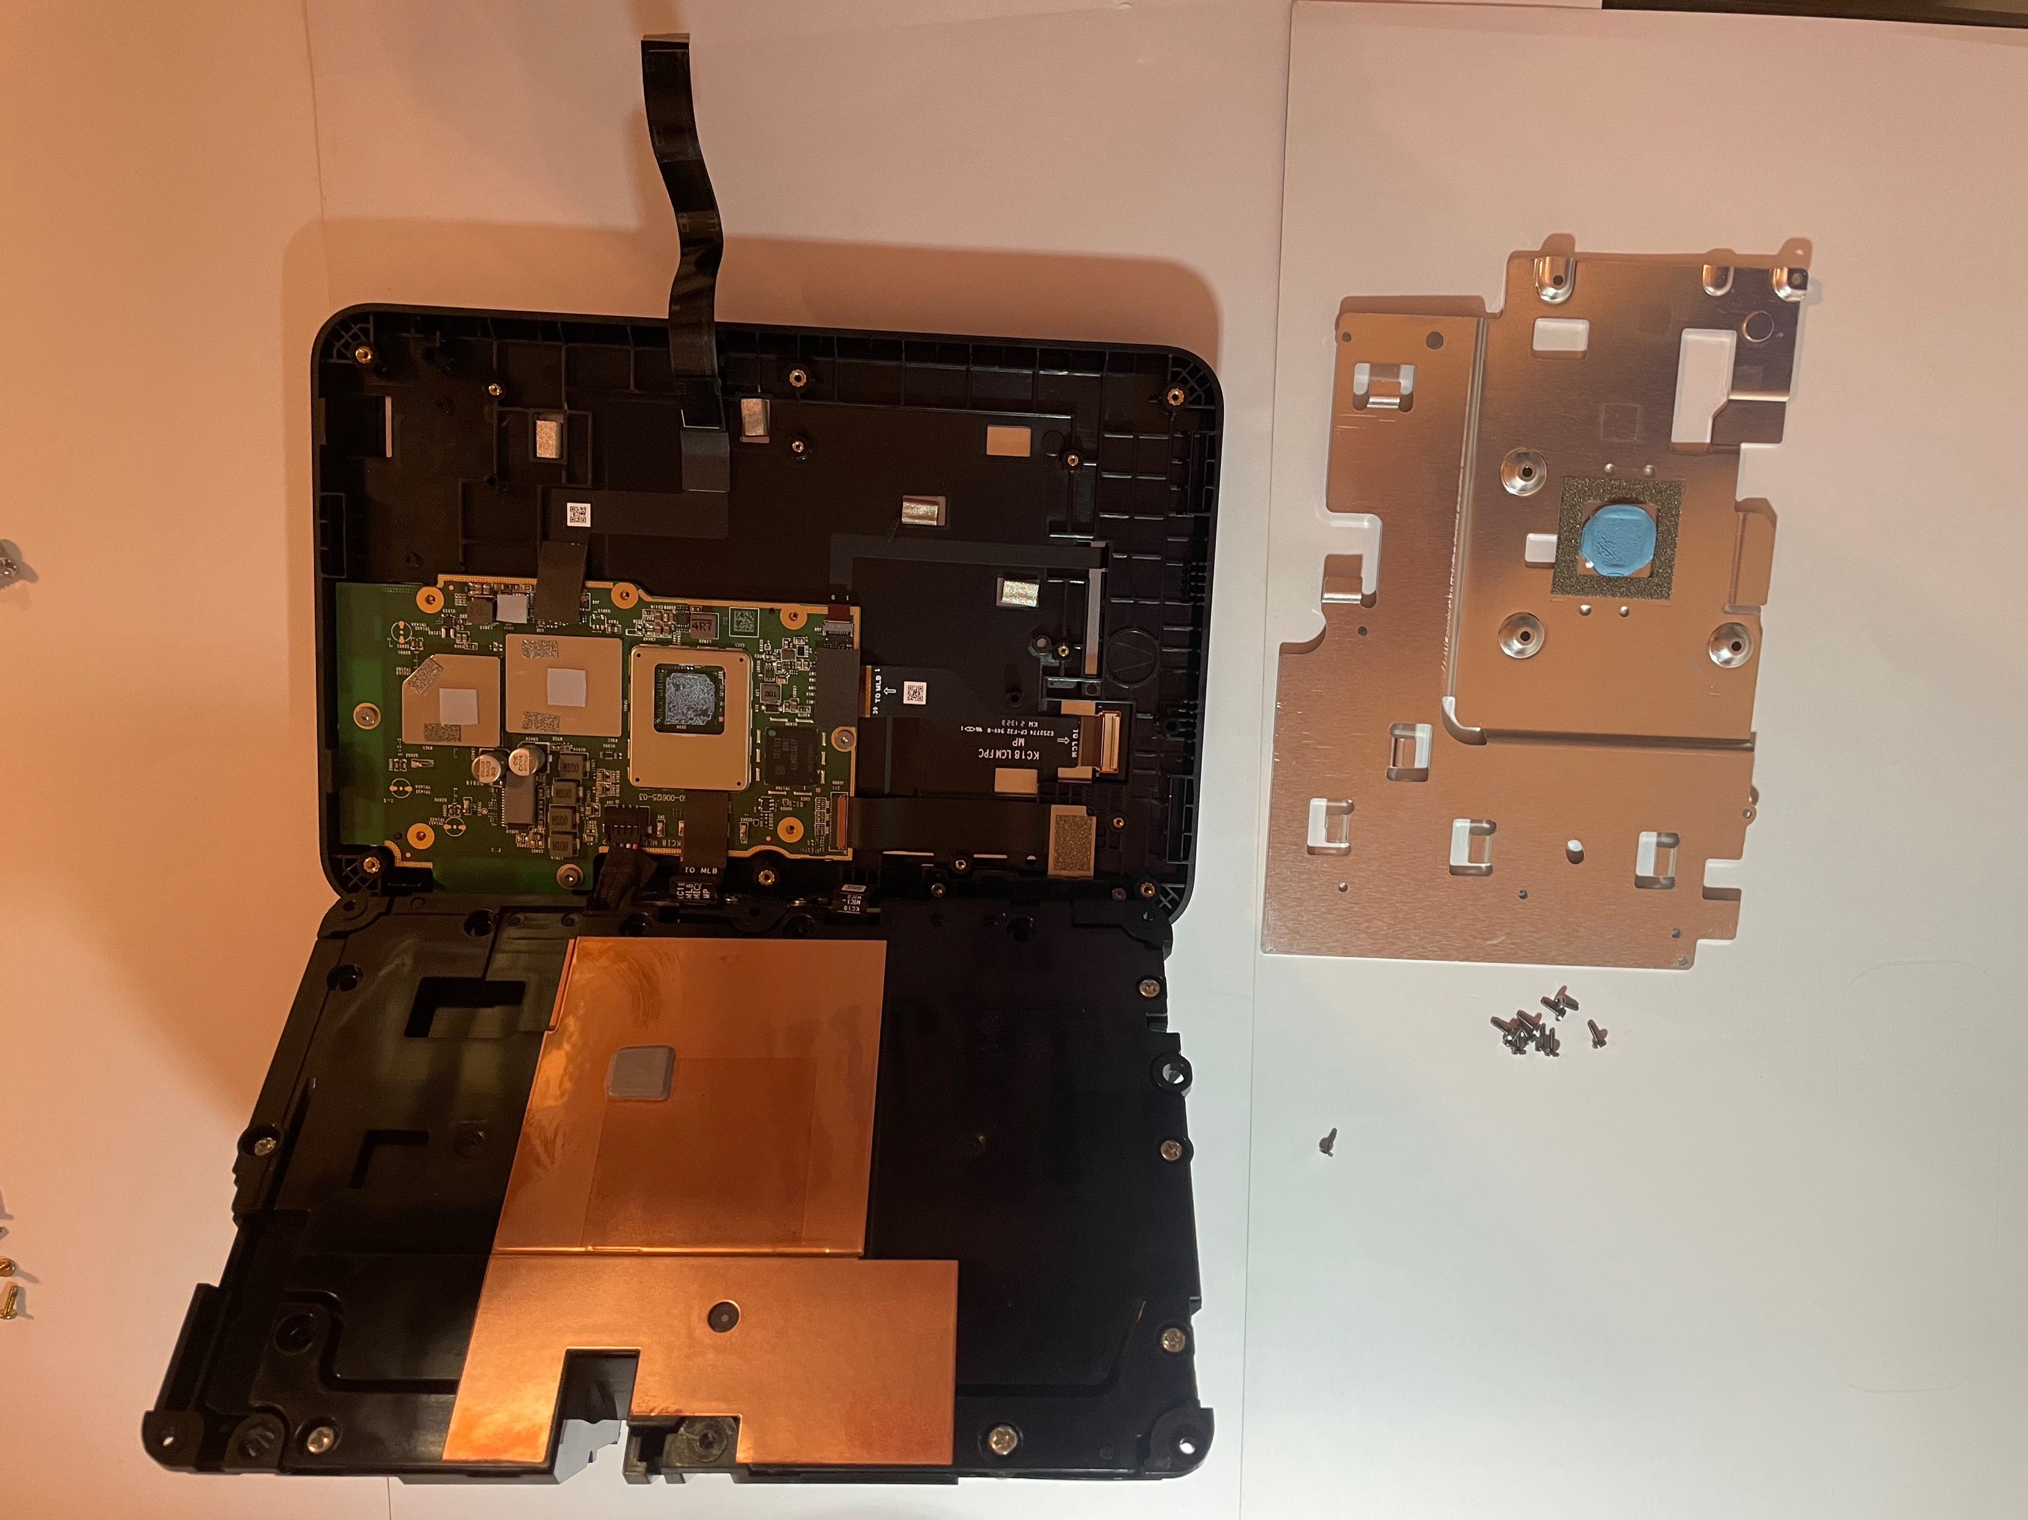
Remove the T5 Screws to Remove the Protective Plate of Logic Board

Slide 15
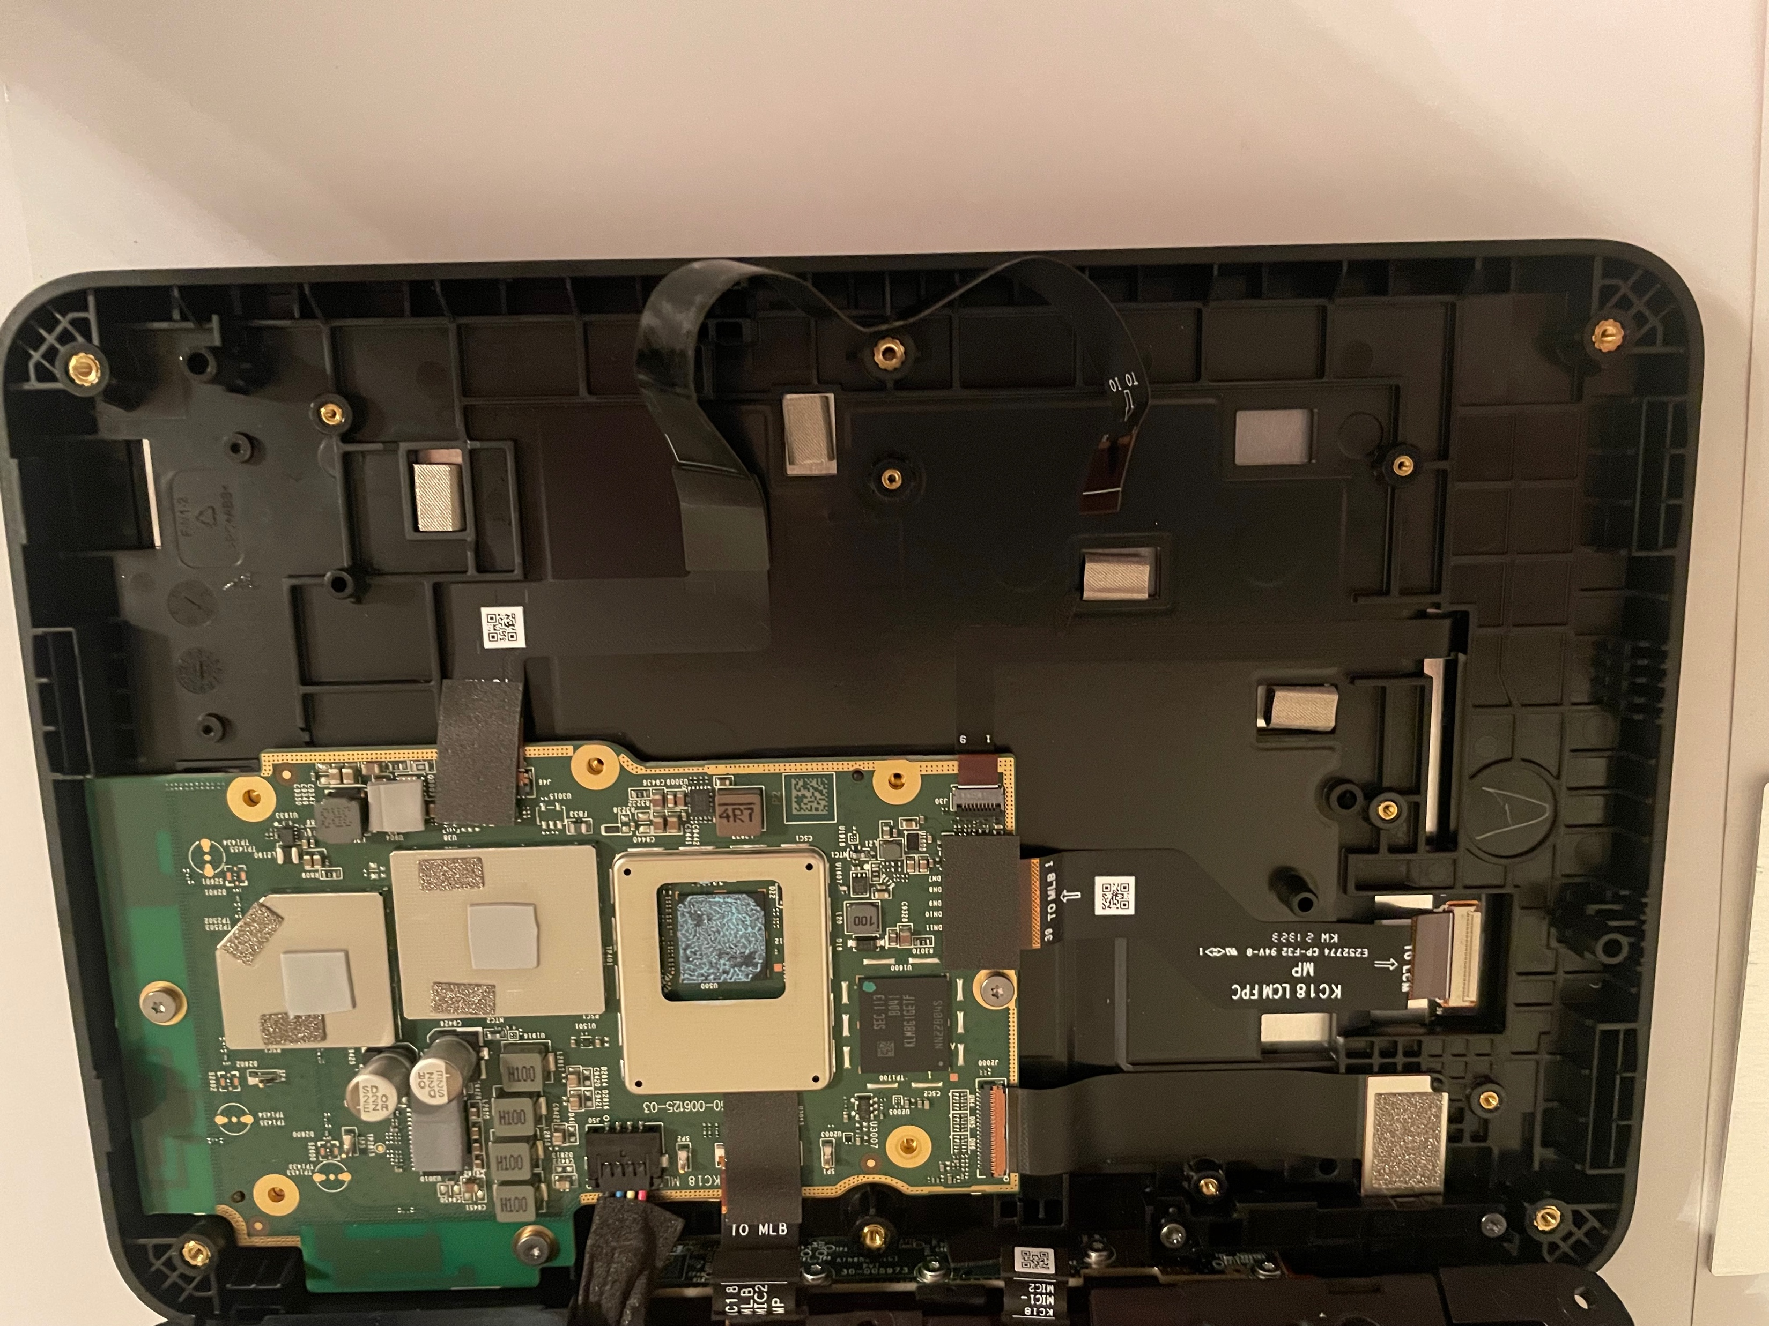
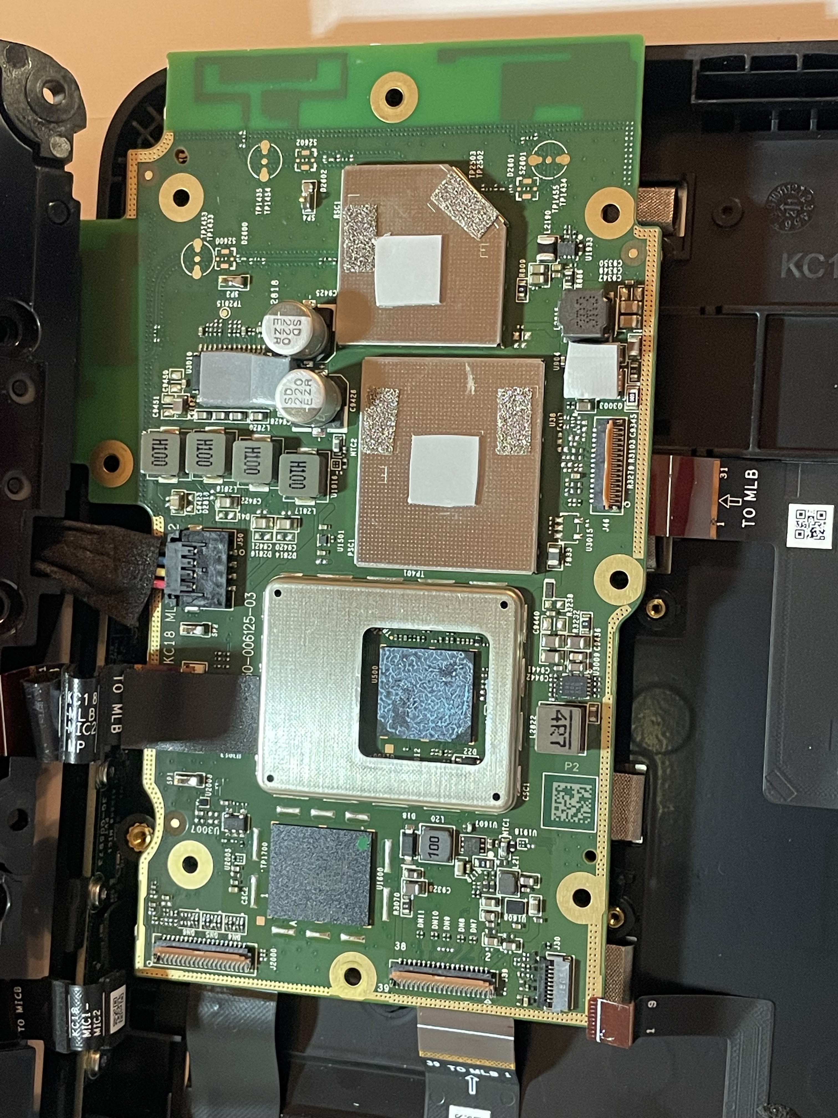
Remove the 5 Adhesive Tapes & Connections to Screen

Slide 16
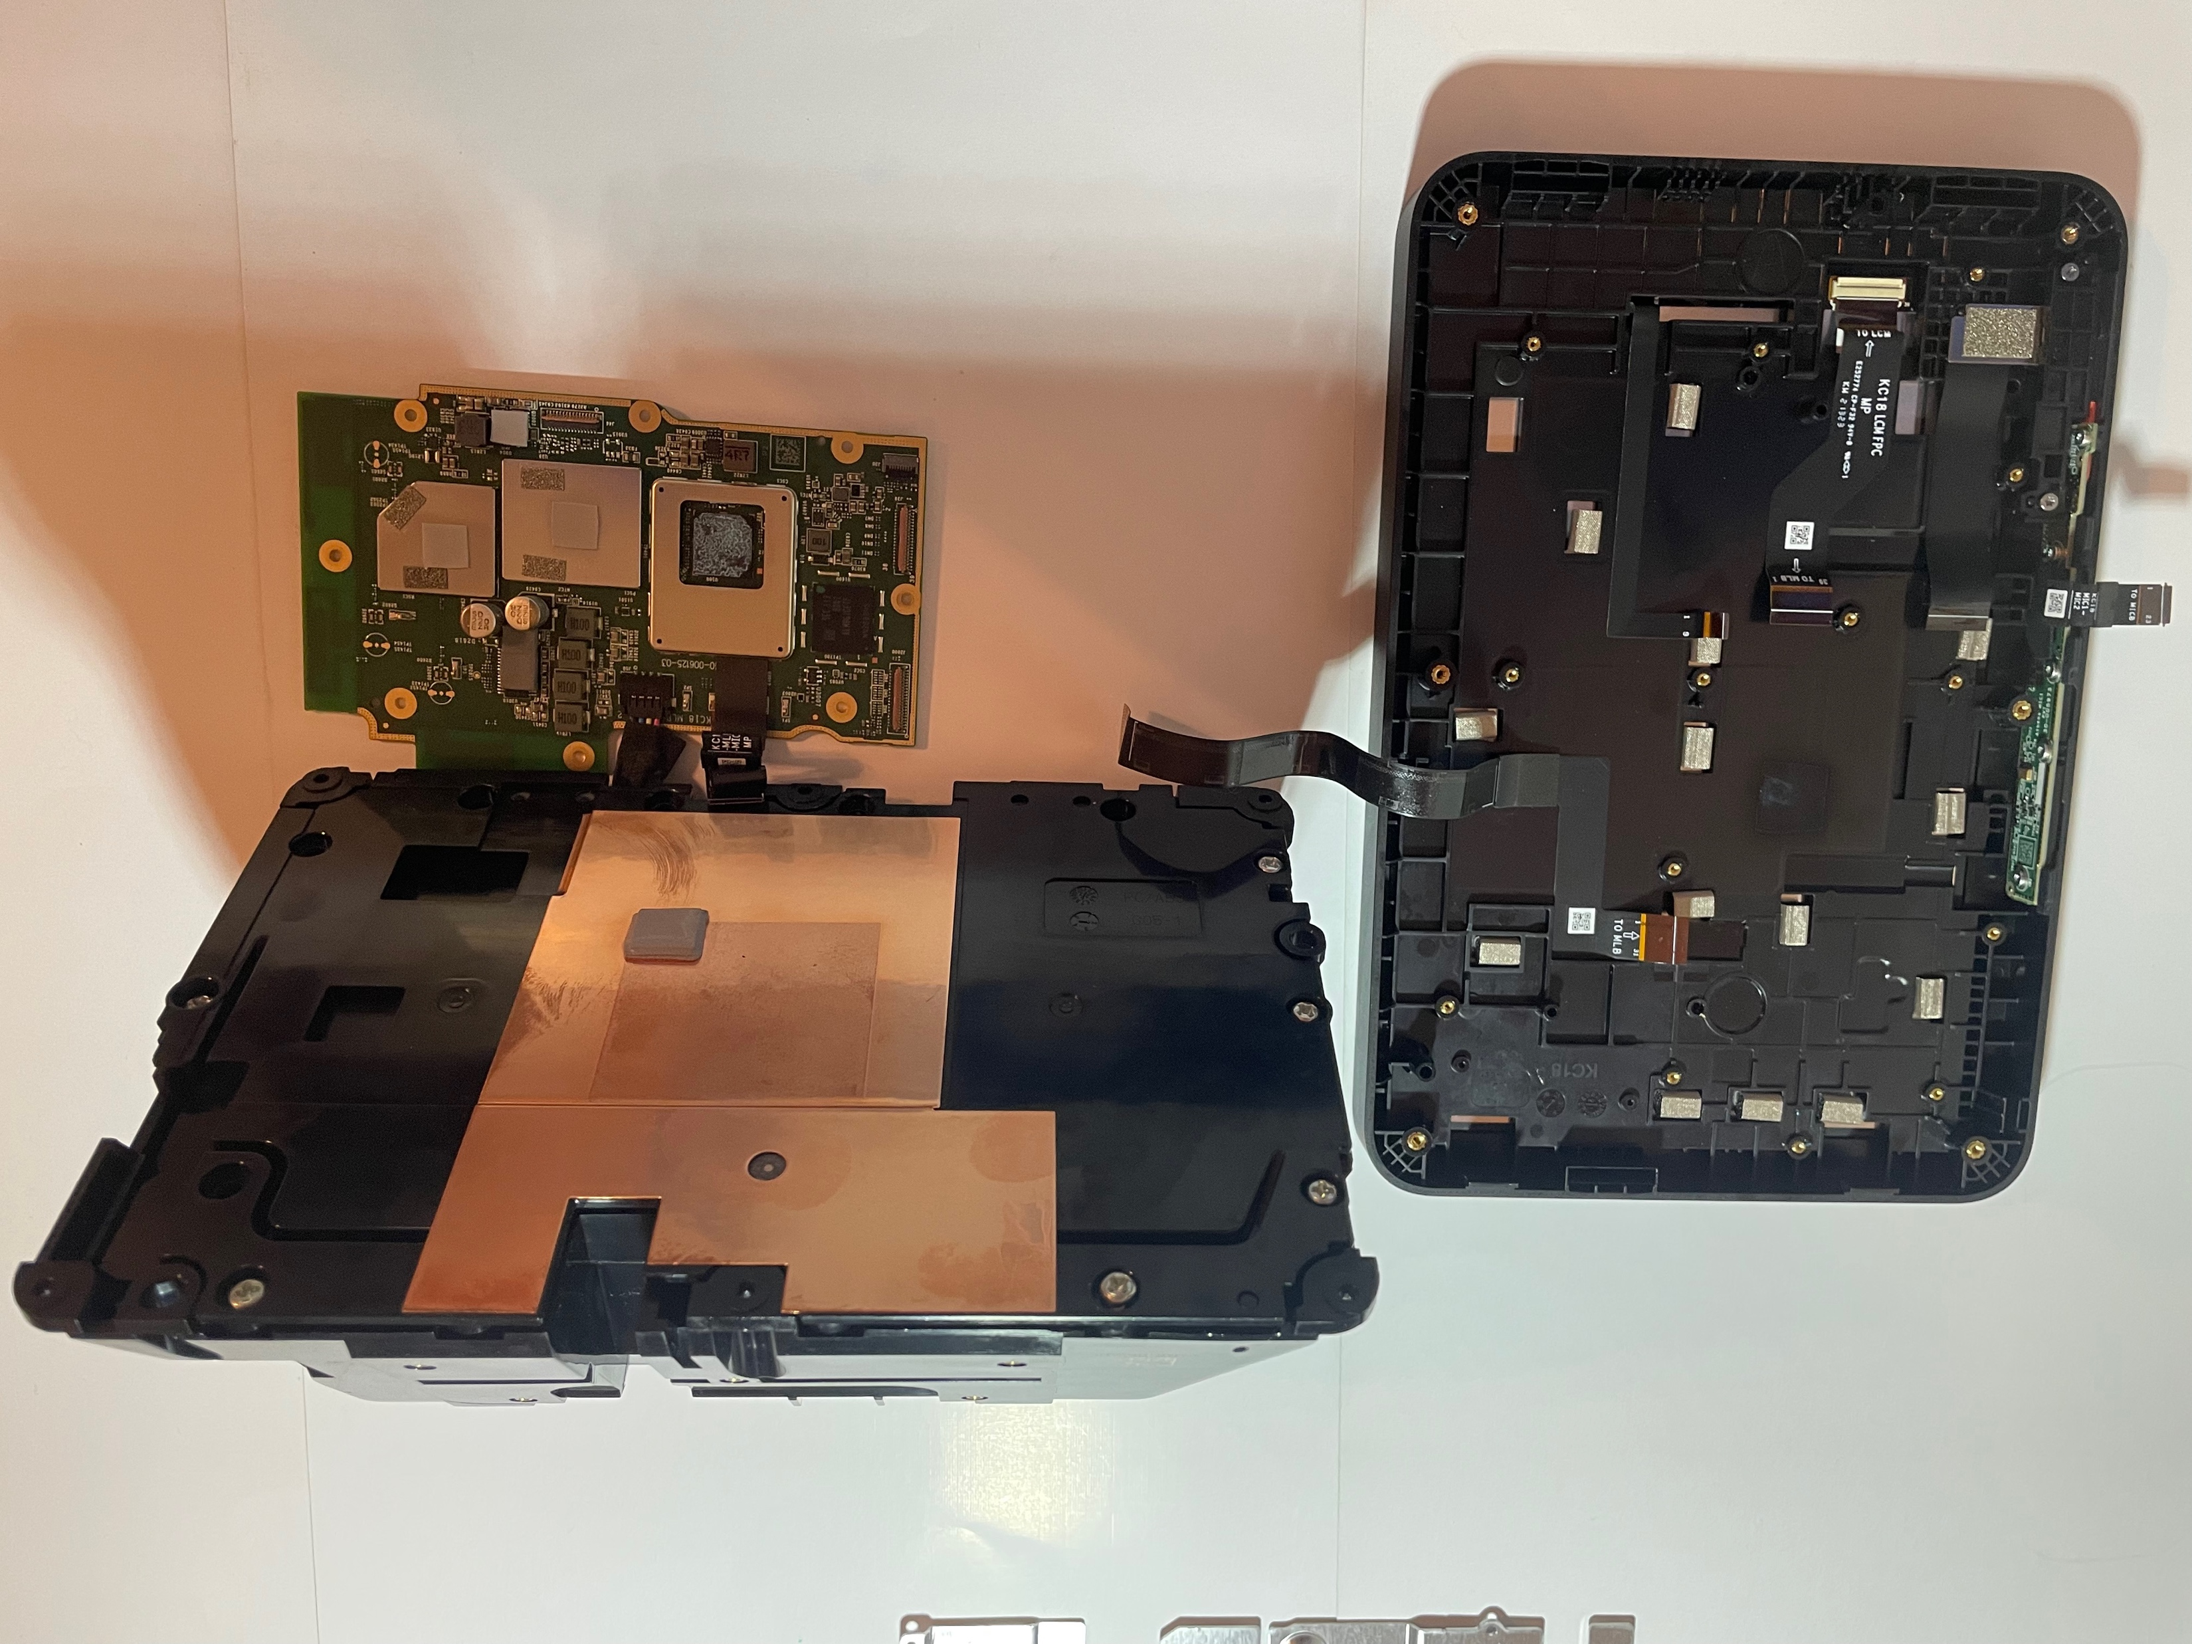
Logic Board Separates from Screen
Yet one audio connection to the speaker is to be removed to separate it from Speaker, also

Slide 17
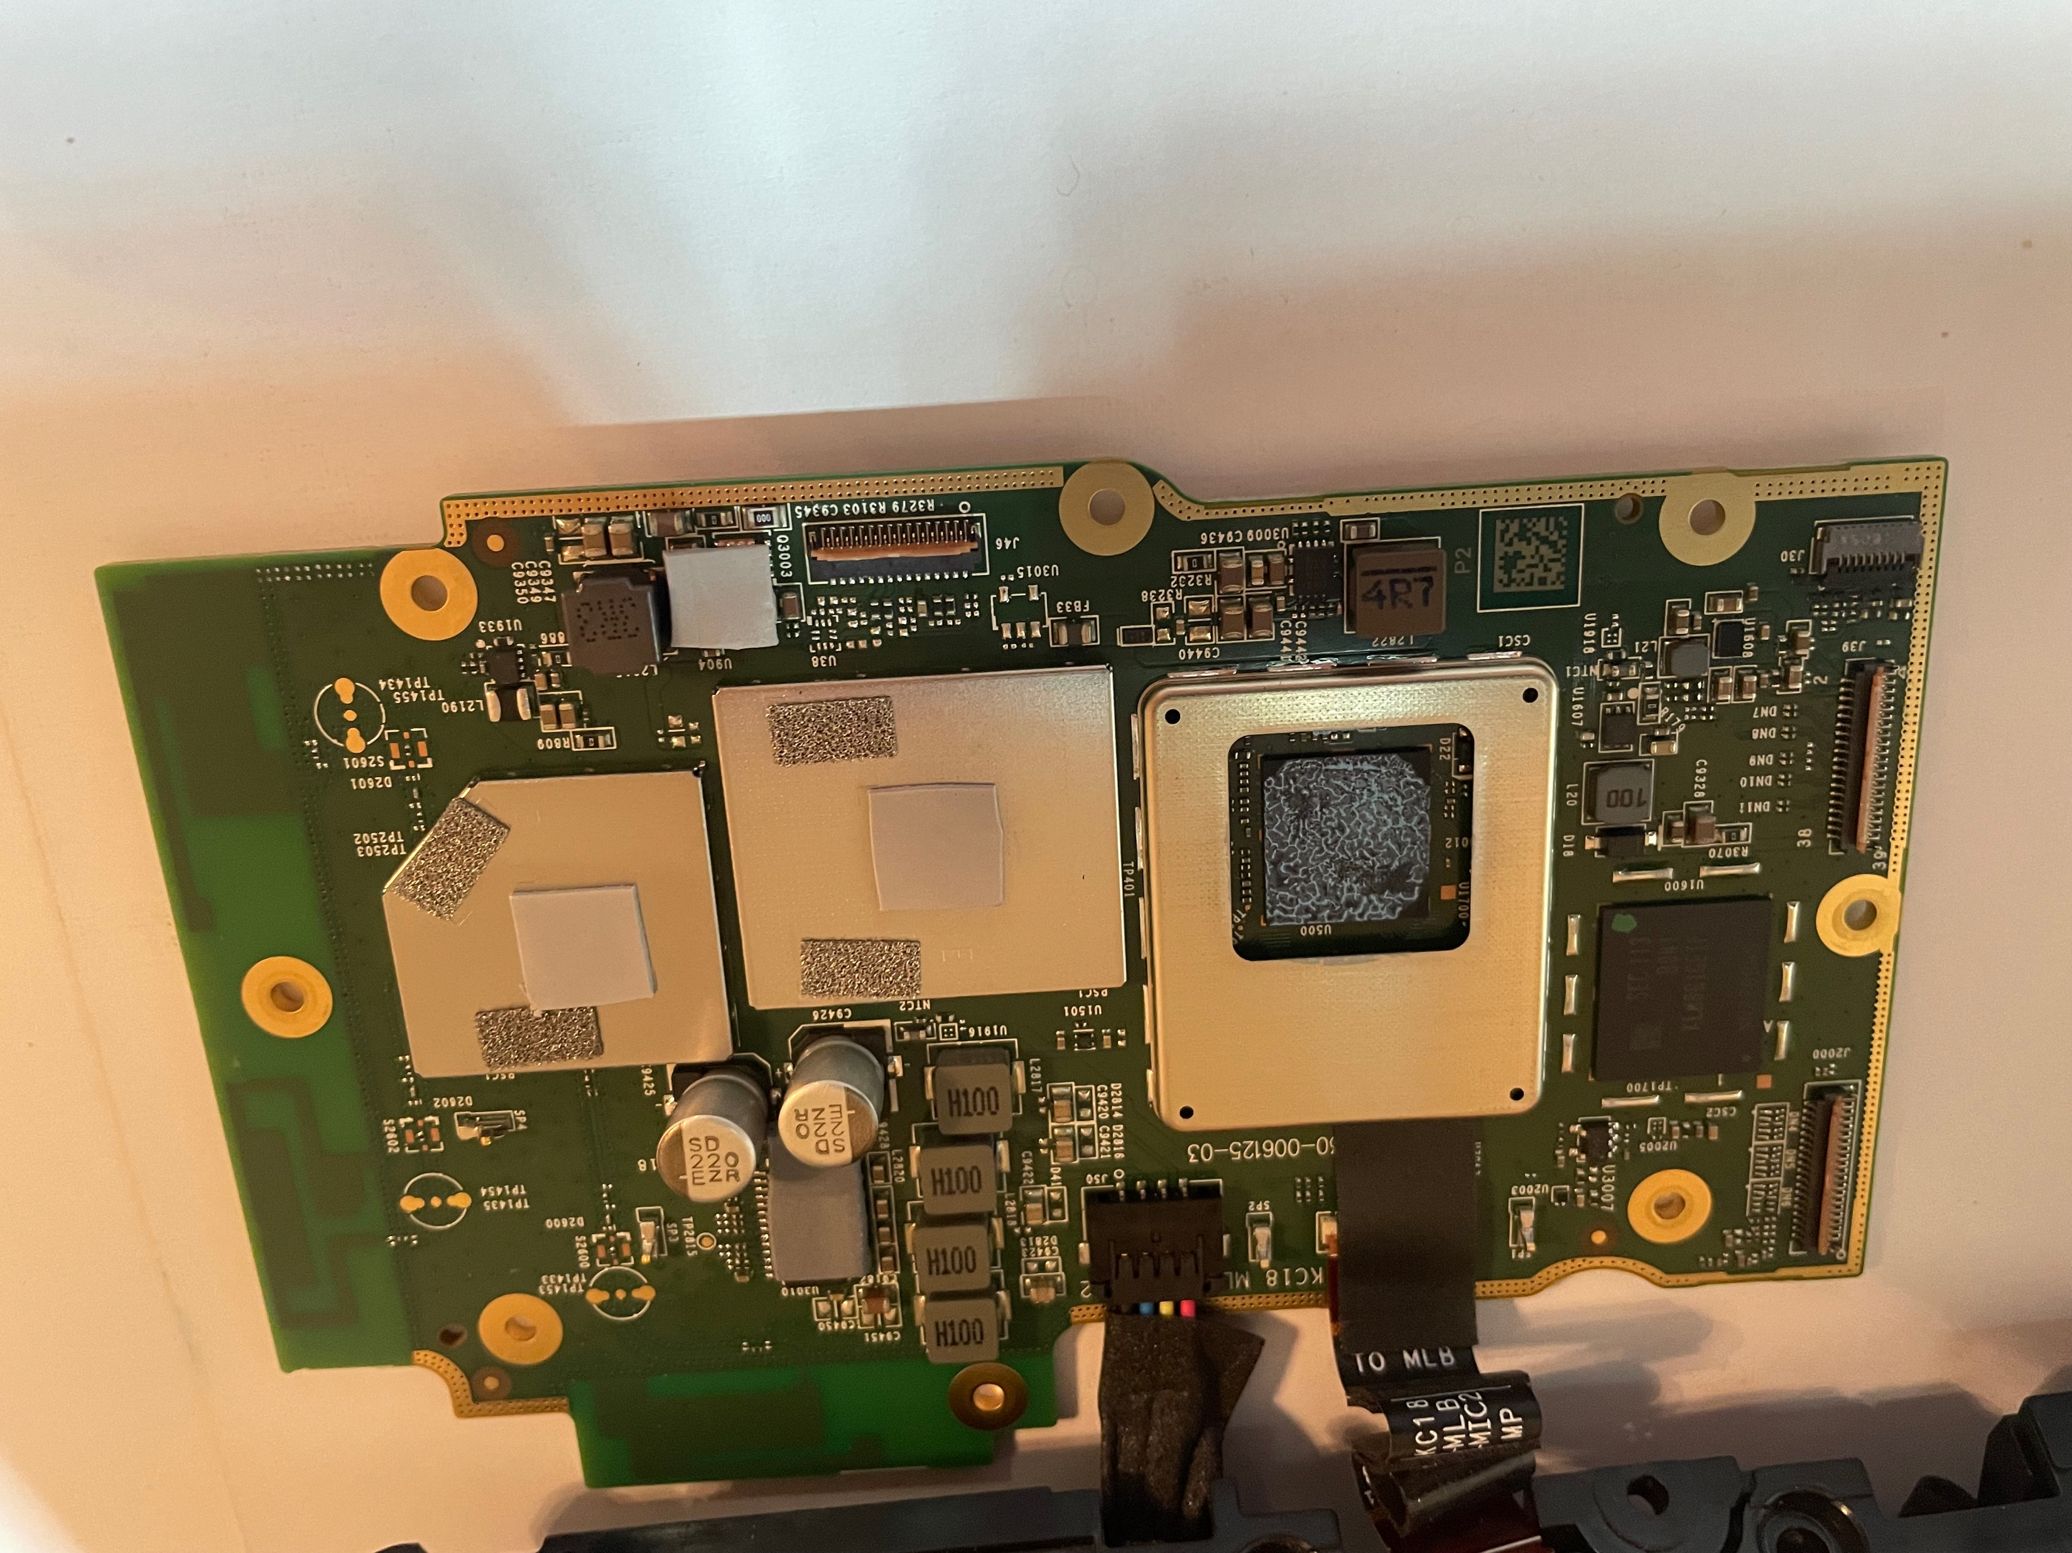
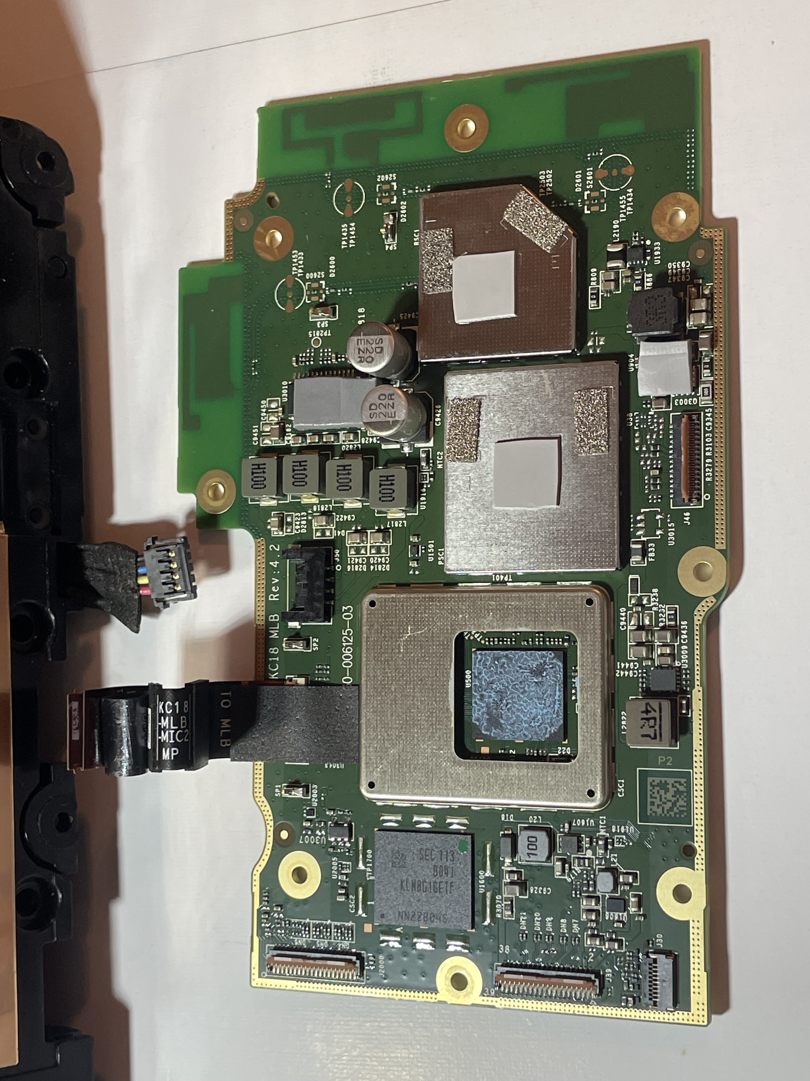
Remove Connection of Logic Board to Speaker

Slide 18
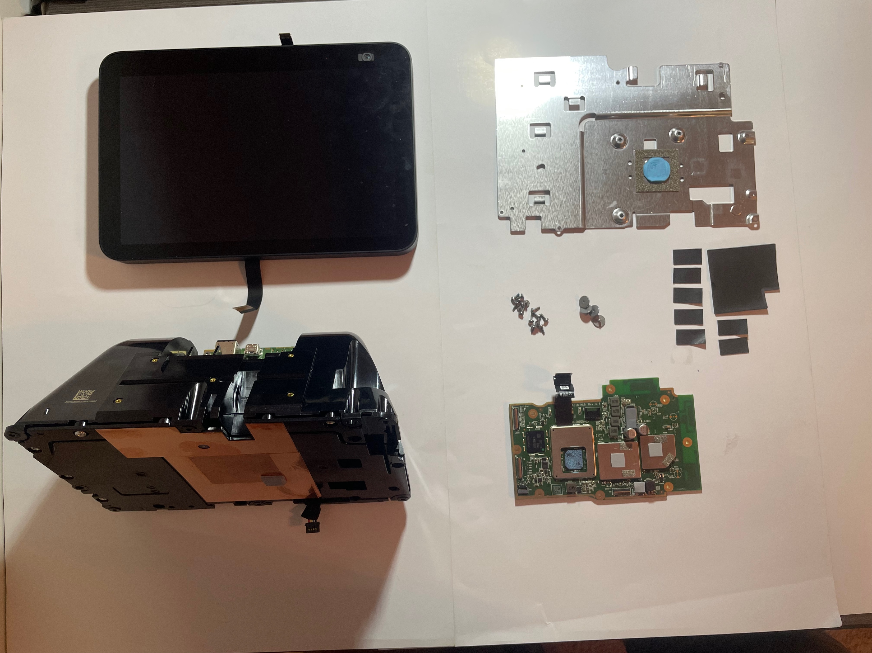
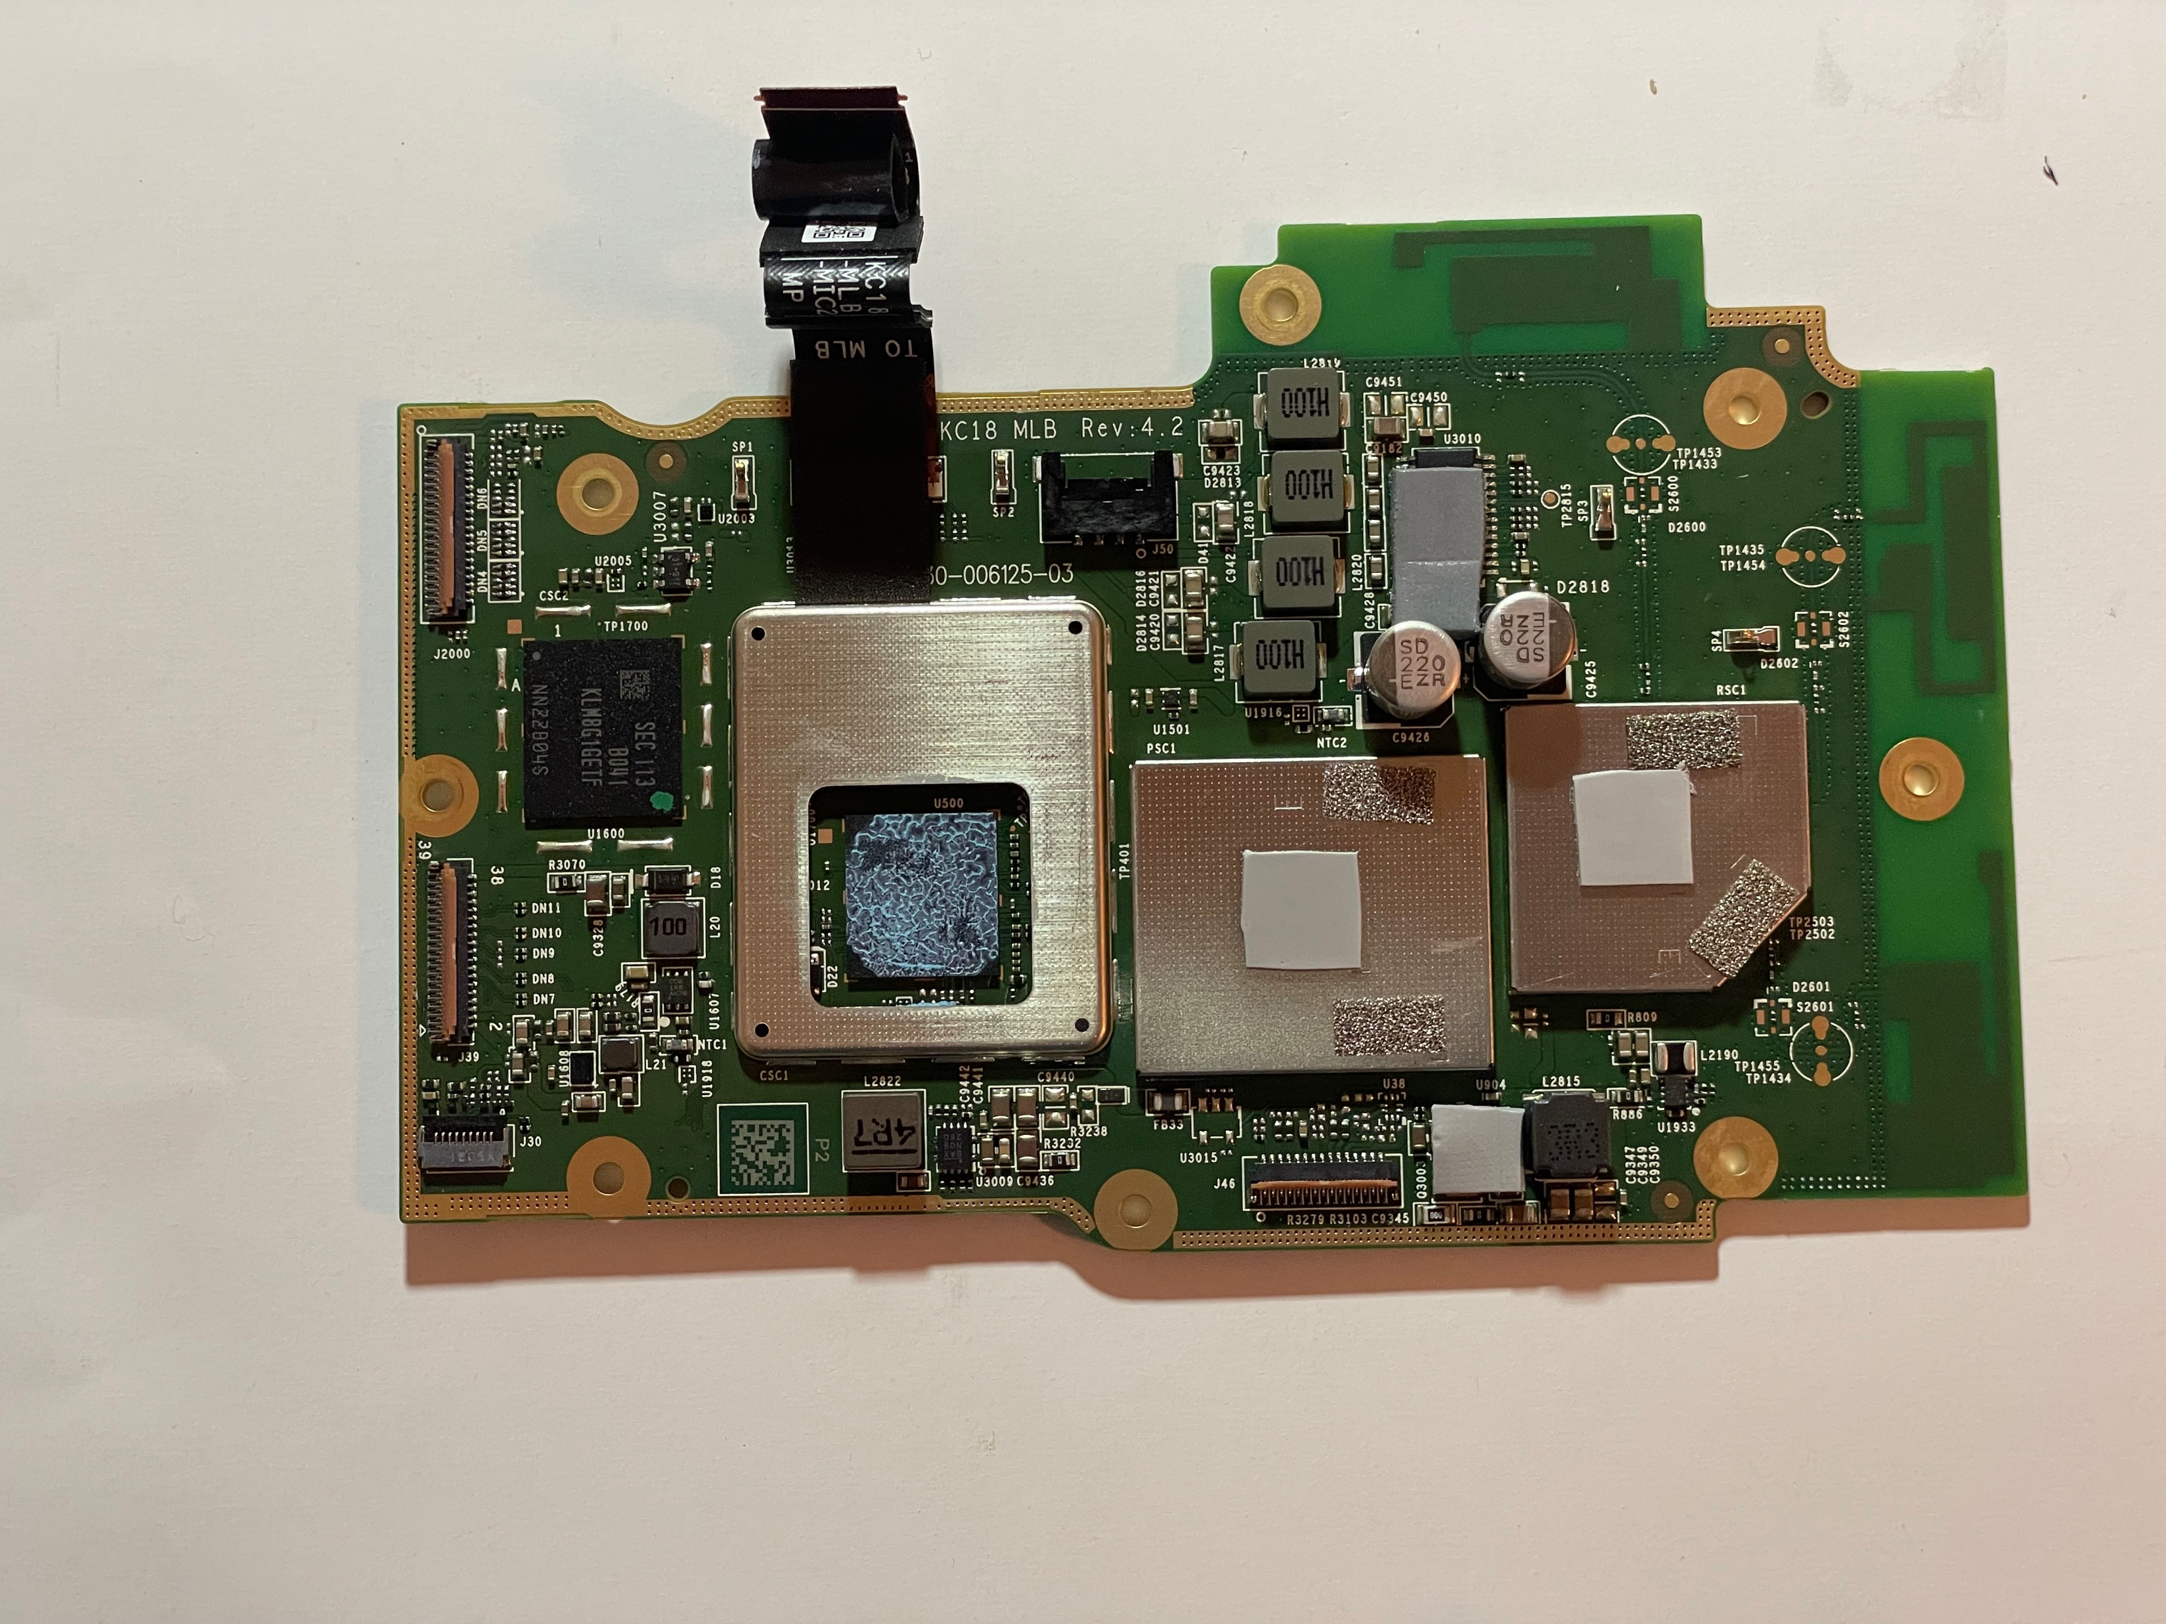
Logic Board Separated from All Parts

Slide 19
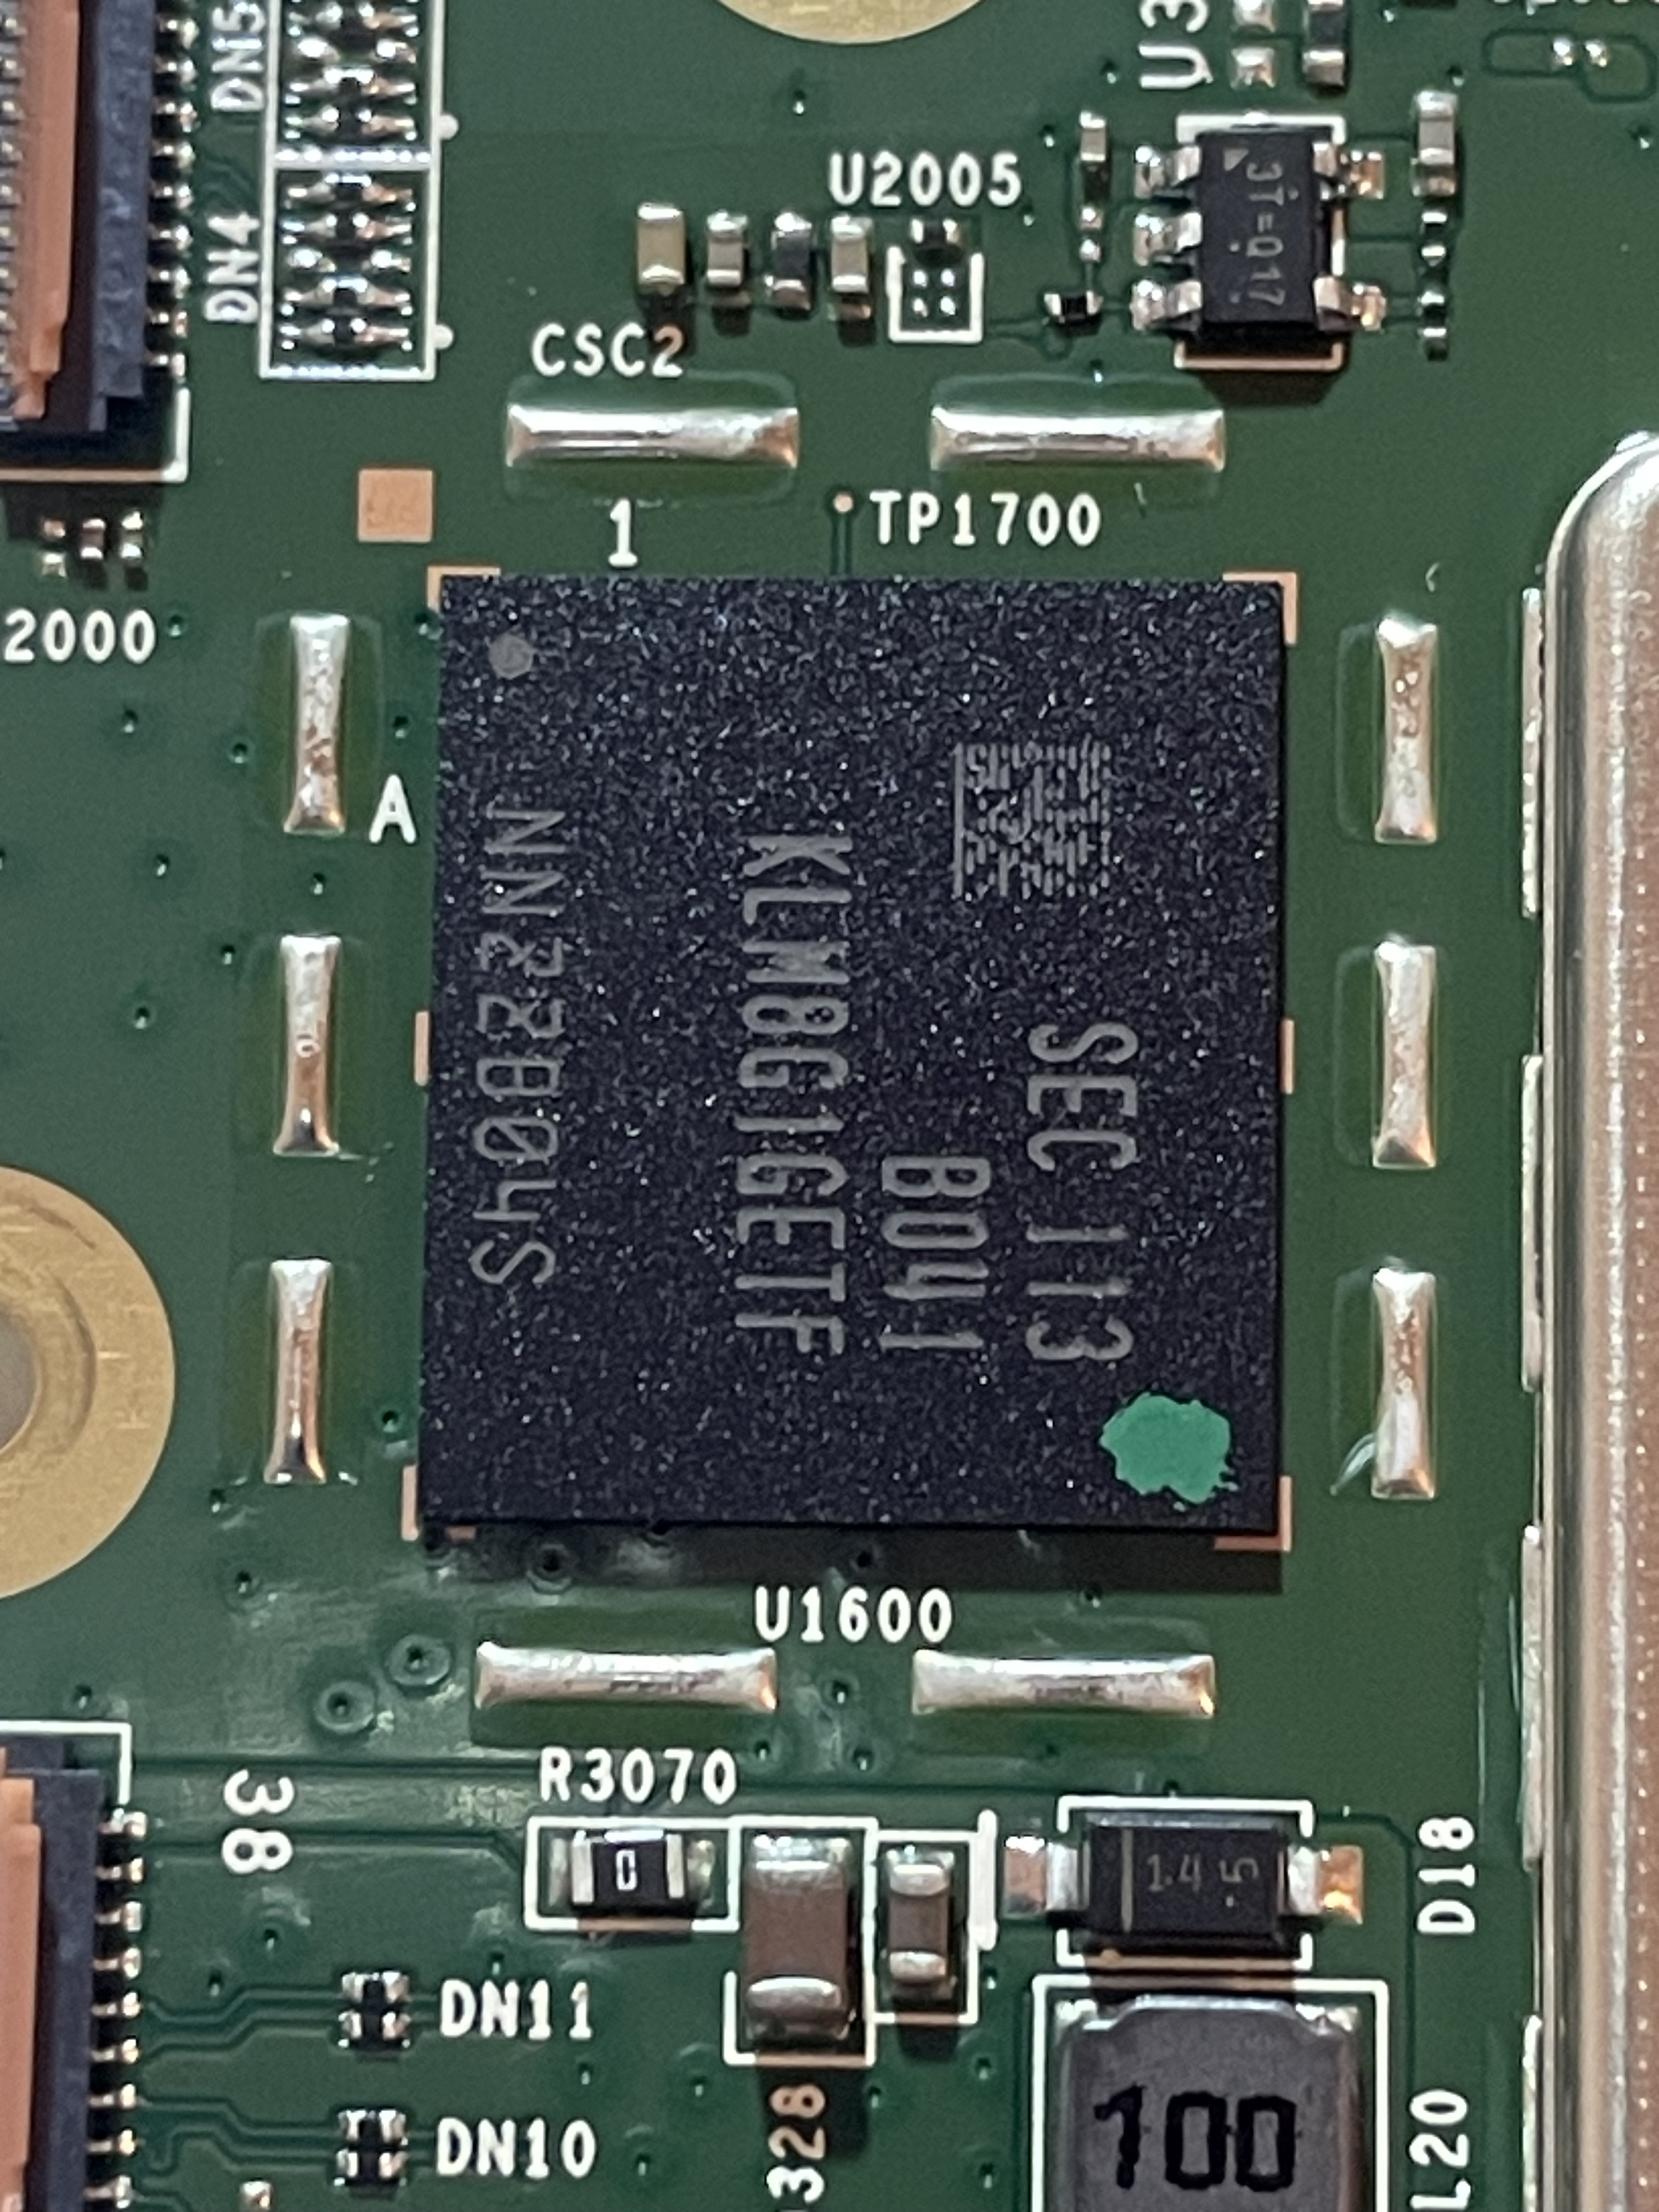
eMMC Exposed

Slide 20
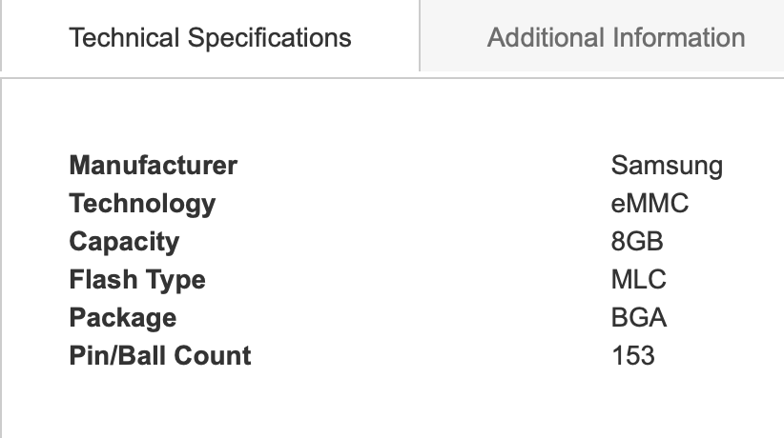
Google Search for ‘klm8g1getf-b041’ Reveals

Slide 21
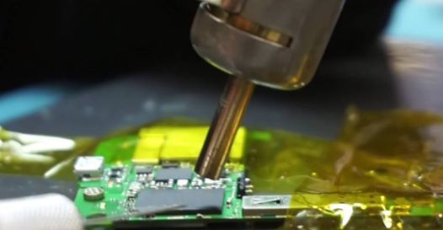
eMMC Chip-off
Image Source: eMMC ISP / Chip-Off Forensic Data Extraction Kit (fonefunshop.com)

Slide 22
Chip-off Process Steps
Apply flux around the eMMC on the logic board.
Set the airflow at 60% on the Rework Station Hot Air Gun.
Configure the temperature as follows:
170°C for the first minute
270°C for the second minute
350°C for the third minute
400°C for the fourth minute
Continuously move the hot air gun nozzle over the eMMC while gently prying it off.
The eMMC should detach smoothly by the end of the fourth minute

Slide 23
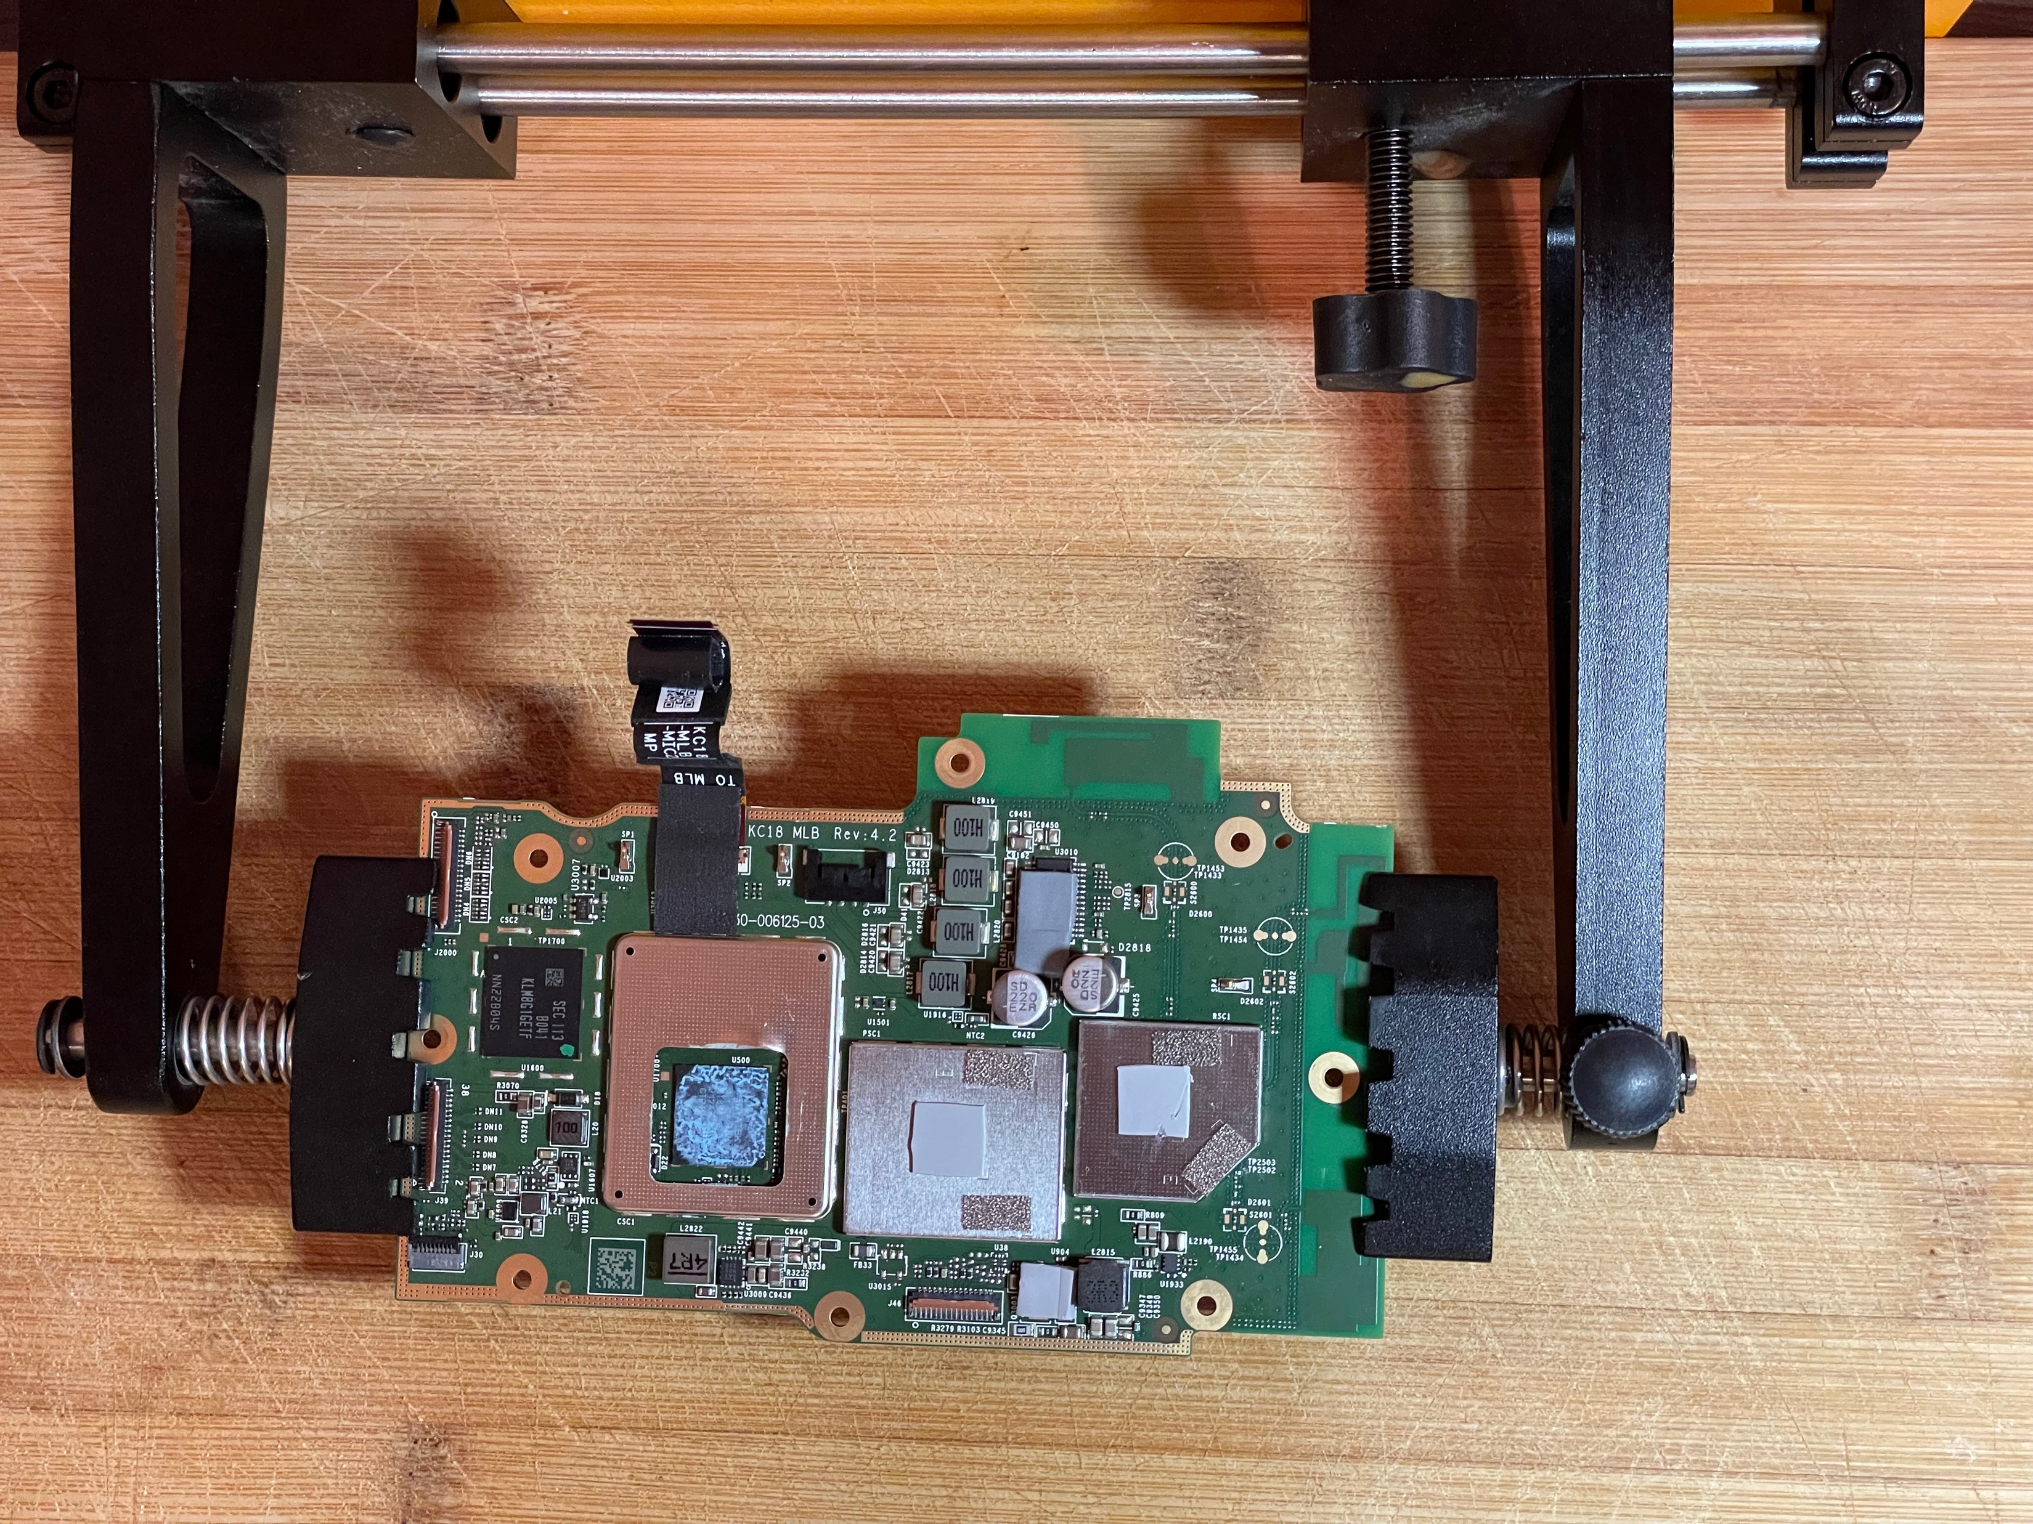
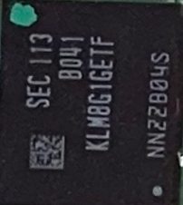
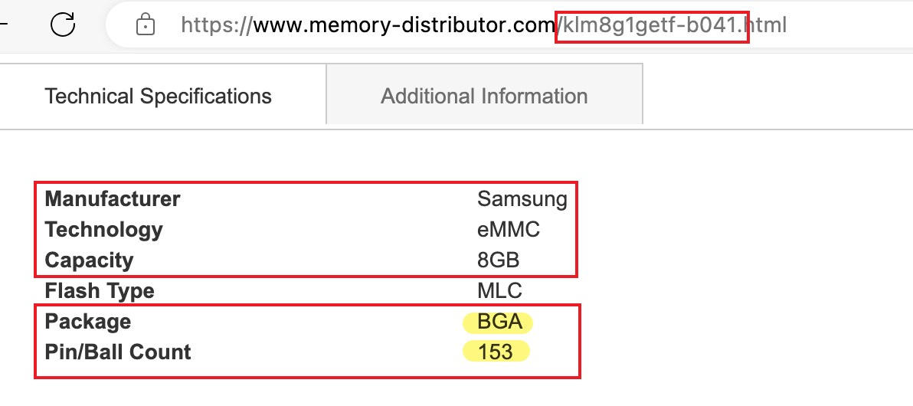
Place Logic Board in Circuit Holder & Locate eMMC
eMMC
Google KLM8G1GTF-B041

Slide 24
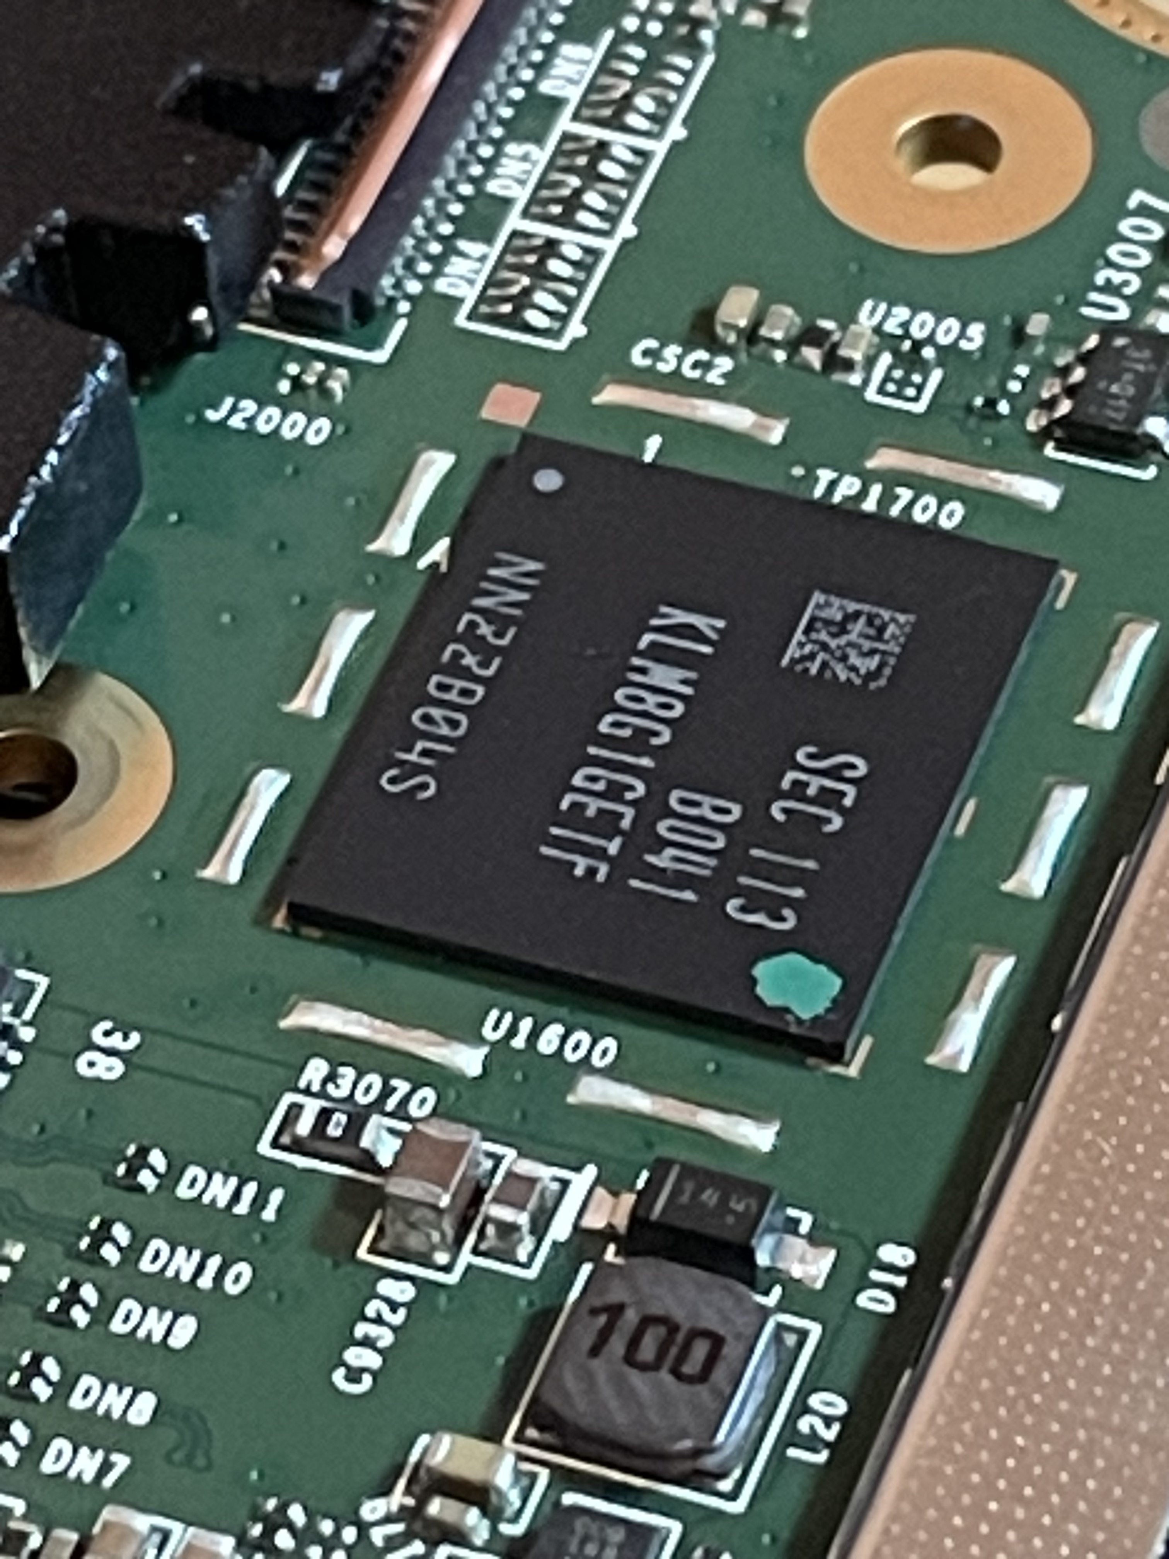
Apply Flux around eMMC on Logic Board

Slide 25
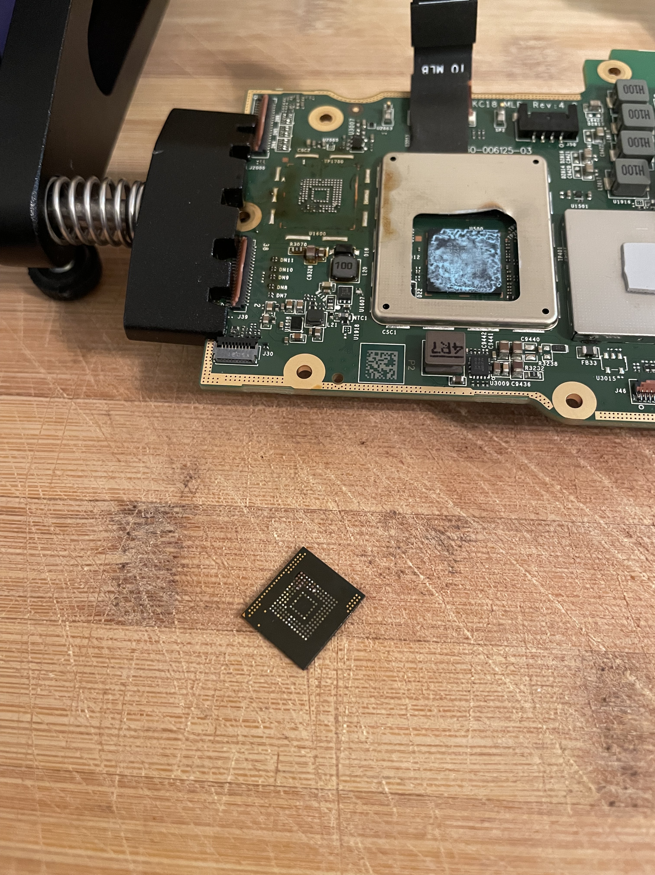
Start Blowing Hot Air - eMMC Removed
Airflow & Temp. Settings
Airflow at 60%
Temperature:
1st min: 170°C
2nd min: 270°C
3rd Min: 350°C
4th min: 400°C
BGA 153 eMMC

